Slide 1
Time Value of Money
Annuity

Slide 2
Annuity
An annuity is an investment paying a fixed amount dollars pmt at the end of each period for T periods
0
1
2
3
T
…
PV=?
pmt
pmt
pmt
…
pmt

Slide 3
Example of Annuity
You have an annual salary of $36,000 and plan to take a loan to buy a house. The bank is willing to allow you to take a mortgage for 30 years with monthly payment equal to 28% of your monthly income. The bank asks for 6% annual interest rate on the mortgage. How much is the bank willing to lend you now?

Slide 4

Example of Annuity
Monthly payment $=0.28×\frac{36,000}{12}=\$840$
Monthly interest rate $=\frac{6\%}{12}=0.005$
# of months $=12×30 = 360$
$pmt=\$840; T=360; r=0.005$
0
1
2
3
360
…
PV=?
$840
$840
$840
…
$840

Slide 5
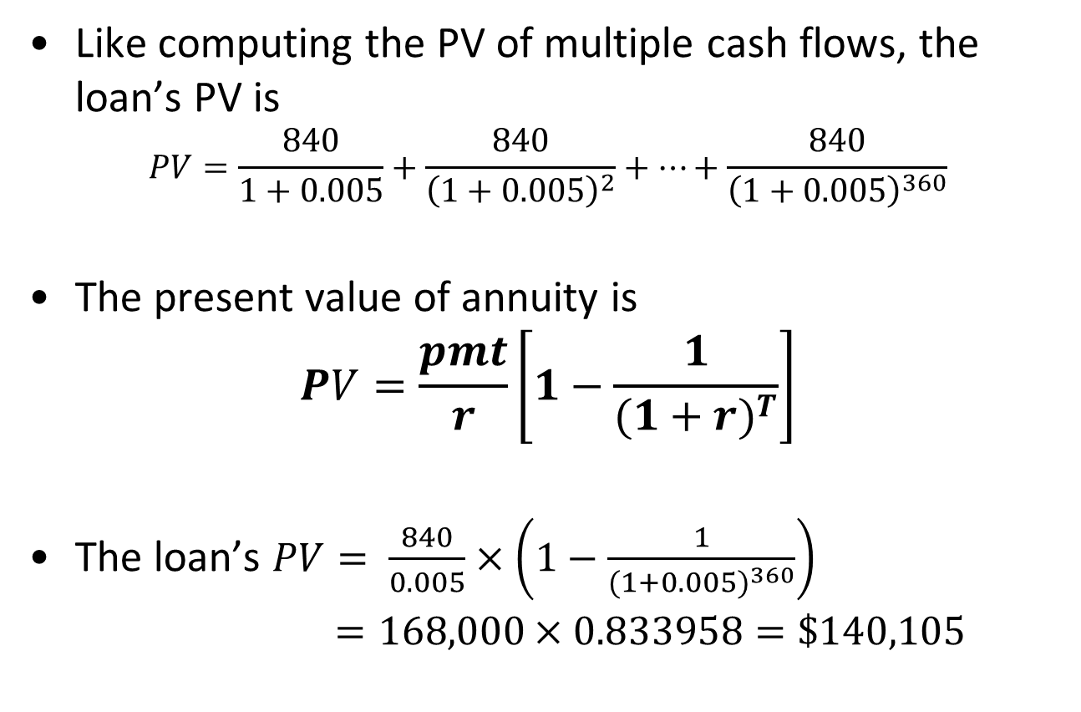
Present Value of Annuity
Like computing the PV of multiple cash flows, the loan’s PV is
$$PV=\frac{840}{1+0.005}+\frac{840}{{\left(1+0.005\right)}^{2}}+…+\frac{840}{{\left(1+0.005\right)}^{360}}$$
The present value of annuity is
$$PV=\frac{pmt}{r}\left[1−\frac{1}{{(1+r)}^{T}}\right]$$
The loan’s $PV= \frac{840}{0.005}×\left(1−\frac{1}{{(1+0.005)}^{360}}\right)$
$=168,000×0.833958=\$140,105$

Slide 6
Finding the Payment
Given the present value ($PV$) of the annuity, the periodic payment ($C$) is
$$pmt=\frac{PV∙r}{\left[1−\frac{1}{{\left(1+r\right)}^{T}}\right]}$$

Slide 7
Mortgage Loan
Mr. Smith has arranged for a 25-year mortgage loan of $400,000. The annual interest rate on the loan is 12%. The bank requires Mr. Smith to make payments at the end of every month. How many dollars is each payment?
$PV=\$400,000$, $r=\frac{12\%}{12}=1\%$, $T=12×25=300$
$pmt=\frac{400,000×1\%}{\left[1−\frac{1}{{\left(1+1\%\right)}^{300}}\right]}=\$4,212.90$

Slide 8
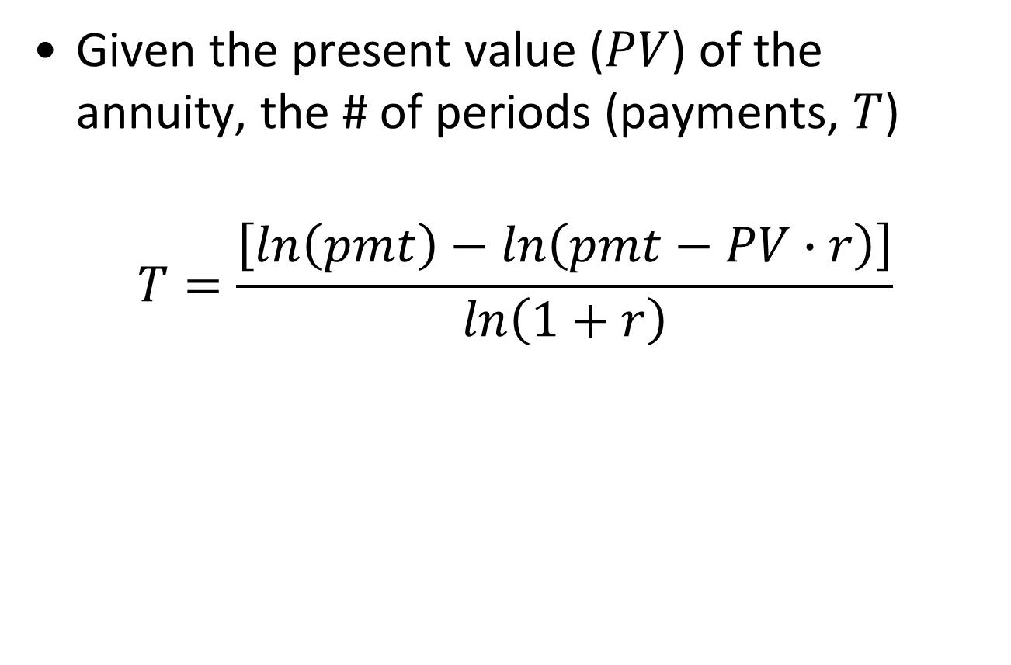
Finding the # of Periods
Given the present value ($PV$) of the annuity, the # of periods (payments, $T$)
$$T=\frac{\left[ln\left(pmt\right)−ln\left(pmt−PV∙r\right)\right]}{ln\left(1+r\right)}$$

Slide 9
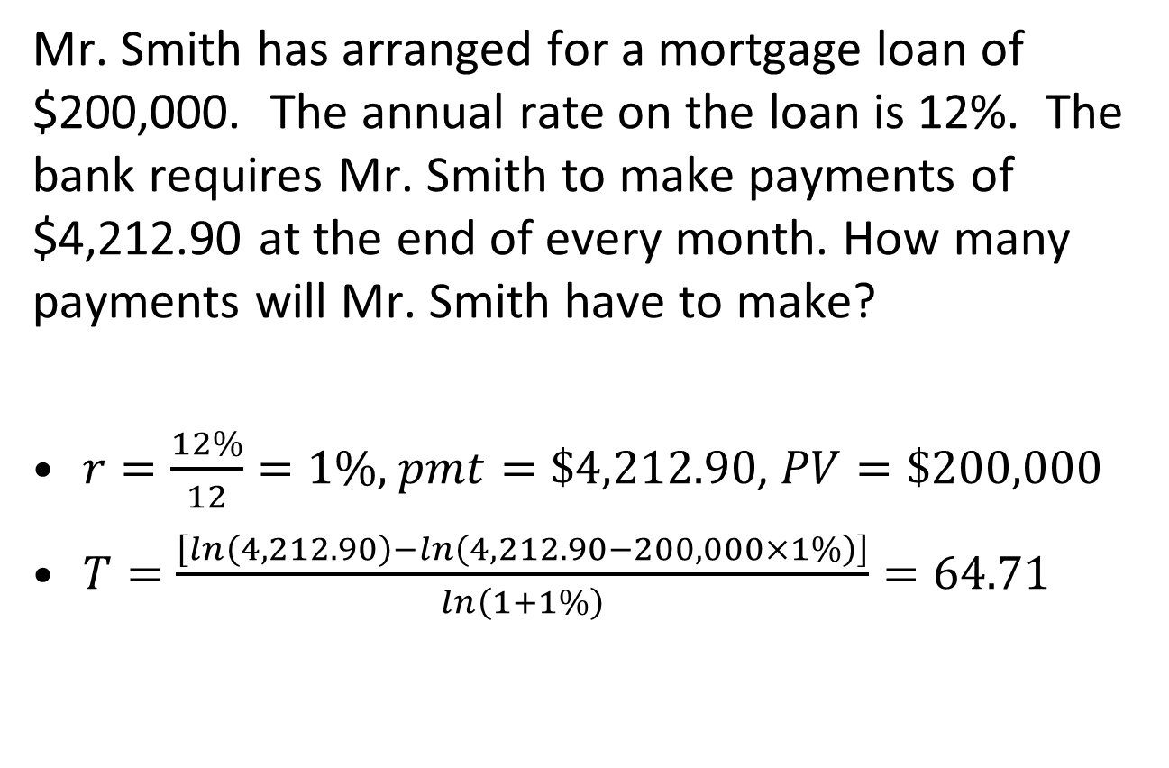
Mortgage Loan
Mr. Smith has arranged for a mortgage loan of $200,000. The annual rate on the loan is 12%. The bank requires Mr. Smith to make payments of $4,212.90 at the end of every month. How many payments will Mr. Smith have to make?
$r=\frac{12\%}{12}=1\%$, $pmt=\$4,212.90$, $PV=\$200,000$
$T=\frac{\left[ln\left(4,212.90\right)−ln\left(4,212.90−200,000×1\%\right)\right]}{ln\left(1+1\%\right)}=64.71$

Slide 10
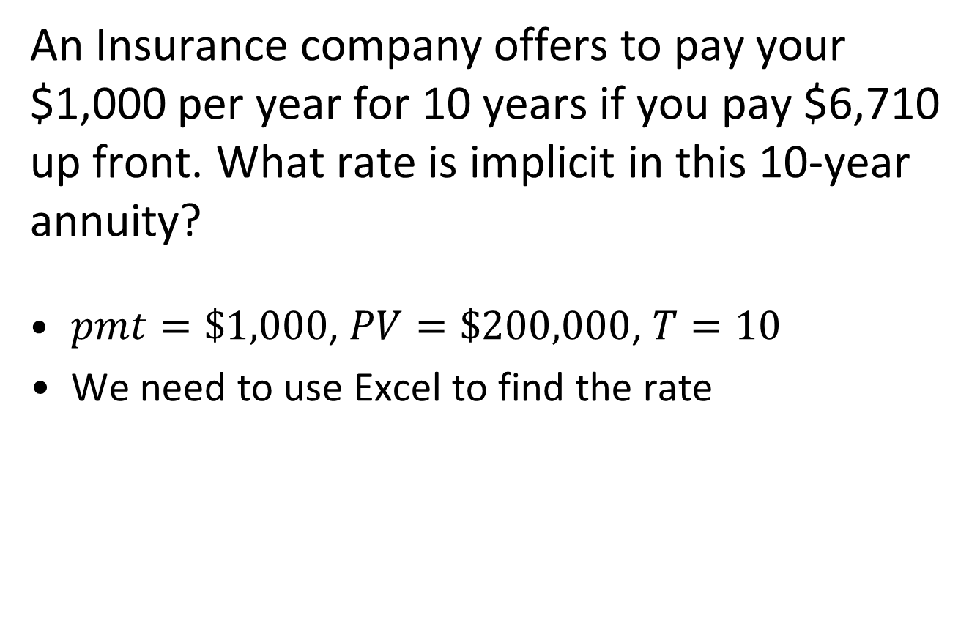
Finding Interest Rate
An Insurance company offers to pay your $1,000 per year for 10 years if you pay $6,710 up front. What rate is implicit in this 10-year annuity?
$pmt=\$1,000$, $PV=\$200,000$, $T=10$
We need to use Excel to find the rate

Slide 11

Future Value of Annuity
The future value of annuity is
$$FV=\frac{pmt}{r}\left[{\left(1+r\right)}^{T}−1\right]$$
0
1
2
3
…
T
pmt
pmt
pmt
pmt
FV=?

Slide 12
Retirement
Suppose you begin saving for your retirement by depositing $2,000 per year in a bank. If the annual interest rate is 7.5%, how much will you have in 40 years?
$pmt = \$2,000$, $T =40$, $r = 7.5\%$
$FV= \frac{2,000}{0.075}×\left({1.075}^{40}−1\right)=\$\text{454,513.04}$

Slide 13
Annuity Due: Present Value
Cash flows occur at the beginning of each period
Present value: $PV=\frac{pmt}{r}\left[1−\frac{1}{{(1+r)}^{T}}\right]\left(1+r\right)$
0
1
2
3
T
…
pmt
pmt
pmt
pmt
…
PV=?

Slide 14
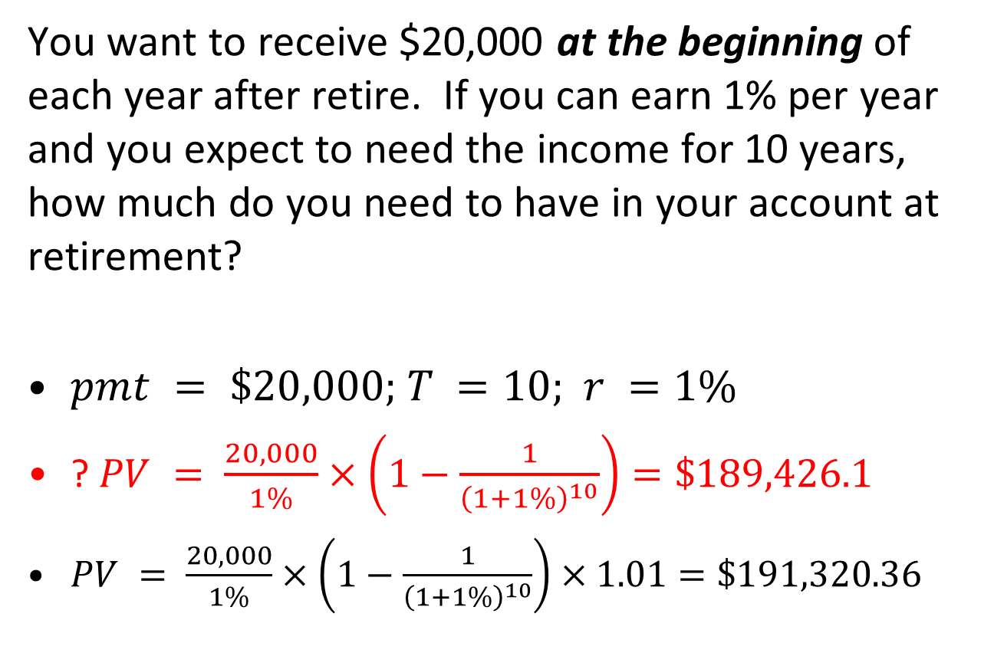
Retirement
You want to receive $20,000 at the beginning of each year after retire. If you can earn 1% per year and you expect to need the income for 10 years, how much do you need to have in your account at retirement?
$pmt = \$20,000;$ $T =10;$ $r =1\%$
? $PV = \frac{20,000}{1\%}×\left(1−\frac{1}{{\left(1+1\%\right)}^{10}}\right)=\$189,426.1$
$PV = \frac{20,000}{1\%}×\left(1−\frac{1}{{\left(1+1\%\right)}^{10}}\right)×1.01=\$191,320.36$
Notes:
189,426.1 is the amount we need in account one year before retirement. $\$189,426.1×1.01=\$191,320.36$ is the amount we need in account right before retirement.

Slide 15
Annuity Due: Future Value
Cash flows occur at the beginning of each period
Future value: $FV=\frac{pmt}{r}\left[{\left(1+r\right)}^{T}−1\right]\left(1+r\right)$
0
1
2
3
T
…
pmt
pmt
pmt
pmt
…
FV=?

Slide 16
Saving to Buy a House
You are saving for a new house and you put $10,000 per year in an account paying 8%. The deposit is made at the beginning of each year. How much will you have at the end of year 3?
$pmt= \$10,000$, $T =3$, $r =8\%$
? $FV = \frac{10,000}{0.08}×\left({1.08}^{3}−1\right)=\$32,464$
$FV = \frac{10,000}{0.08}×\left({1.08}^{3}−1\right)×1.08=\$\text{35,061.12}$
Notes:
$$32,464×1.08=\$35,061.12$$

