Slide 1
Investing through Mutual Funds

Slide 2
Direct Ownership of Securities
Options for direct ownership of securities include:​
Brokerage account​
Investor has high degree of control.​
Costs vary widely.​
Trust account ​
For high net worth individuals.​
High customer service level.​
Separately managed account (SMA)​
Uses technology to adapt model portfolio selected by an investment professional to an individual account.​
Can be customized to limited extent.

Slide 3
Mutual Fund - What is it?
A fund is mutual because​​
all of its returns​
– from interest, dividends, and capital gains – ​
​
and all of its expenses​
​
are shared by the fund’s investors.

Slide 4
Why do we need “Mutual Funds”?
Pros:
Reduction of risk by investment diversification
Ability to sell your investment daily
Access to the expertise of professional money managers
Ability to participate in investment strategies that might not otherwise be available to smaller investors
Administrative convenience and shareholder services
A high level of investor safeguards
Comprehensive reporting that enables easy comparisons among funds

Slide 5
Why do we need “Mutual Funds”?
Cons:
Fees
No control on timing of gains
Less predictable income
No Customization

Slide 6
Types of Mutual Funds
Fundamentally three varieties of mutual funds:​
Equity funds (stocks)​
Fixed Income funds (bonds)​
Money Market funds

Slide 7
Types of Mutual Funds
There are two basic mutual fund management types:​
passively managed / index funds​
actively managed​
Exchange-Traded Fund (ETF)

Slide 8
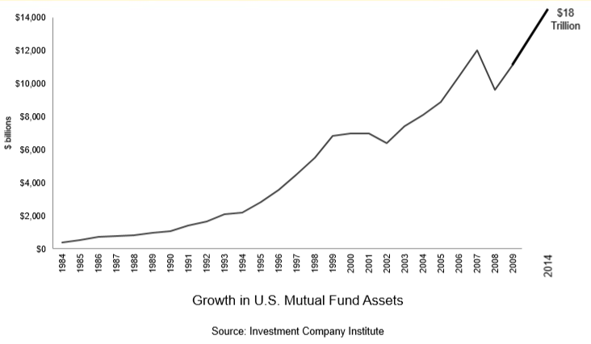
Trends in Mutual Funds
Investment Company Institute (ICS)
www.ici.org

Slide 9
Mutual Fund Characteristics
Morningstar
www.morningstar.com
Example:
http://www.morningstar.com/funds/xnas/prdsx/quote.html

Slide 10
How to Buy Mutual Funds
No-load funds: sometimes called No Transaction Fee (NTF) funds — do not charge sales commissions ​
Buy directly from a mutual fund company, like The Vanguard Group or T. Rowe Price​
through an online or discount brokerage, like ING Sharebuilder, E*Trade, Fidelity or Charles Schwab ​
Load funds: pay a sales commission, at the time of purchase or at the time of sale.​
Class A: pay a commission up front​
Class B: no commission at purchase, pay if you sell your shares​
Class C or level load, pay a commission each year

Slide 11
Key Mutual Fund Regulators
Securities and Exchange Commission (SEC)​
Primary regulator​
FINRA​
Oversees distribution activity​
Department of Labor​
Regulates employer-sponsored retirement plans​
State regulators​
Enforcement role

Slide 12
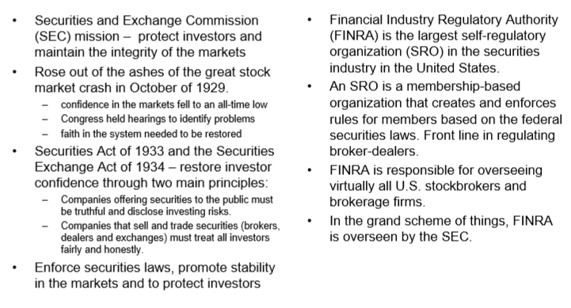
SEC and FINRA

Slide 13
SEC vs Finra
SEC “Regulates”
Lengthy rule making process:
(1) to ensure all technical issues have been addressed
(2) to build consensus
Finra is not a governmental agency but a self-regulatory organization. That is, members join together to police themselves
(1) to license individuals who participate in the selling of mutual funds and securities
(2) to review almost all mutual fund sales and advertising materials
(3) to limit the sales loads that funds charge

Slide 14
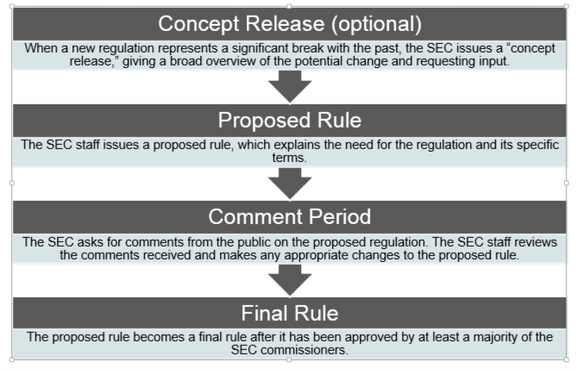
The Regulatory Process

Slide 15
Some Current Discussions
SEC
https://www.wsj.com/articles/sec-approves-paperless-mutual-fund-reports-1528205042
https://www.wsj.com/articles/mutual-funds-win-as-sec-proposes-to-keep-lid-on-liquidity-disclosures-1521051671
https://www.wsj.com/articles/why-fund-managers-accountants-may-rest-easier-this-weekend-1525611600
Finra
https://www.wsj.com/articles/finra-arbitrators-let-thousands-of-brokers-purge-infraction-records-1542459600
https://www.fa-mag.com/news/finra-orders-firms-to-self-report-529-plan-share-class-violations-43019.html

Slide 16
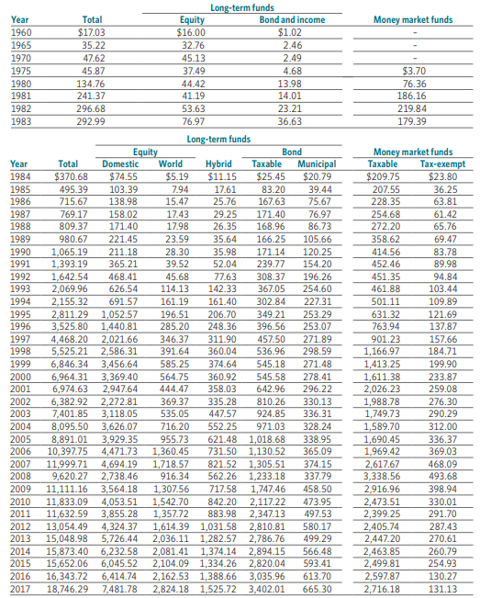
Understanding Mutual Fund Investors
Impact of Wealth
Fees
Impact in Stock Market

Slide 17
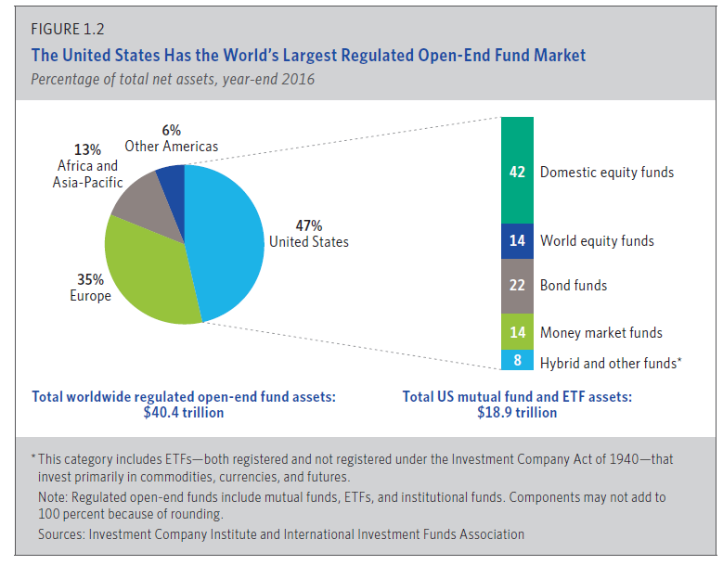
Mutual Funds-World-wide

Slide 18
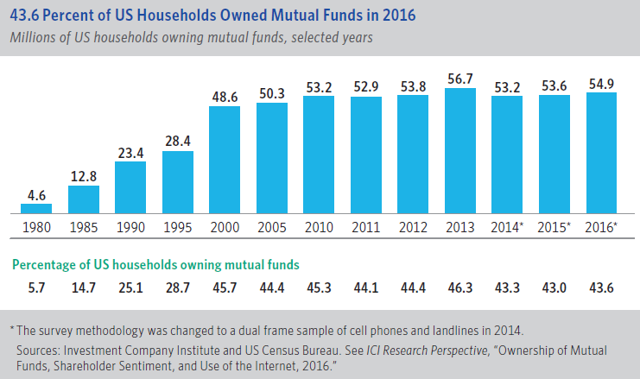
Household Mutual Fund Ownership

Slide 19
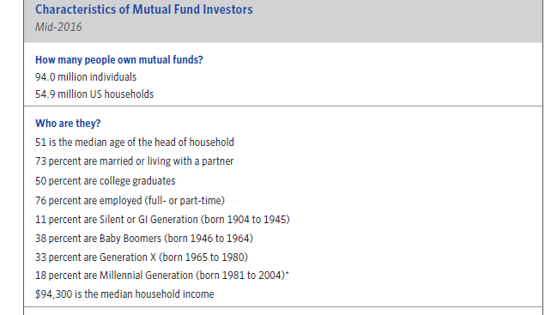
Characteristics of Mutual Fund Investors

Slide 20
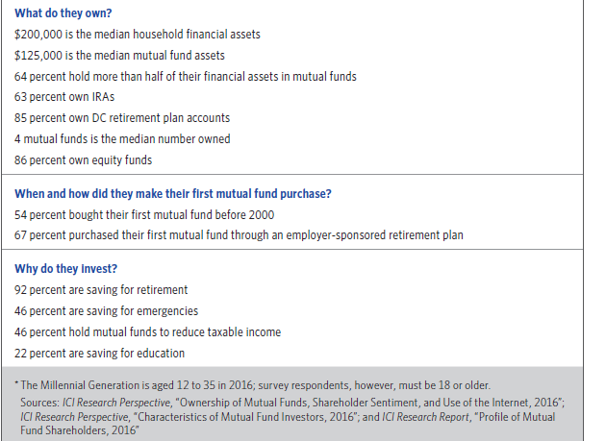
Characteristics of Mutual Fund Investors

Slide 21
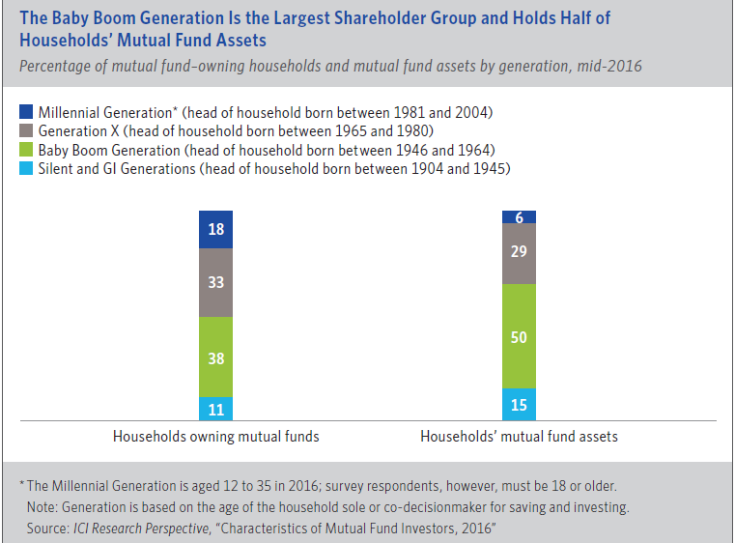
Characteristics of Mutual Fund Investors

Slide 22
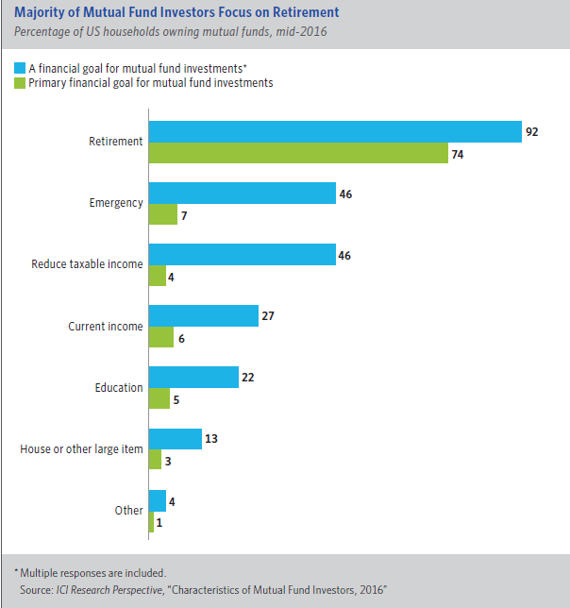
Why Investors Invest in Mutual Funds?

Slide 23
Investment Vehicles - Comparison
Open-end mutual funds​
Permit investors to redeem shares every day.​
Closed-end mutual funds​
Sell shares only once.​
List shares for trading on a stock exchange; price determined by supply and demand.​
Do not redeem shares daily; instead, investors buy/sell on exchange, often for less than NAV.​
Have declined in popularity.

Slide 24
Investment Vehicles - Comparison
Exchange-traded funds​
Shares listed for trading on a stock exchange; price determined by supply and demand.​
Adjust the number of shares outstanding so that the market price remains close to NAV.​
Are tax-efficient.​
Are growing in popularity.

Slide 25
Investment Vehicles - Comparison
Hedge funds​
Aren’t required to register with the SEC, unlike the other commingled vehicles discussed.​
Usually structured as limited partnerships.​
Limit investor ability to redeem.​
Use aggressive investing techniques and are not subject to investment restrictions.​
Generally don’t have a board of directors.

Slide 26
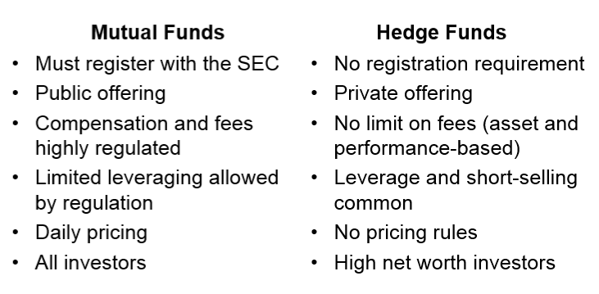
Mutual Funds vs. Hedge Funds

Slide 27
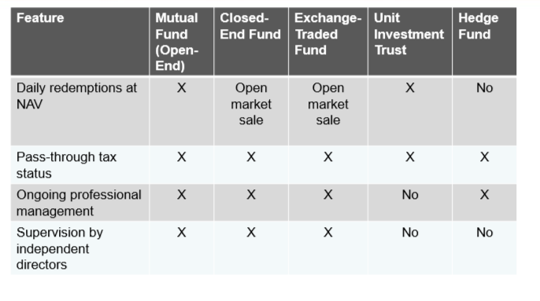
Investment Vehicles - Comparison

