Slide 1
Interest Rates and Bond Valuation
RWJ-Chapter 7

Slide 2
Valuation of Bonds and Stocks
First Principles:
Value of financial securities = PV of expected future cash flows
To value bonds and stocks we need to:
Estimate future cash flows:
Size (how much) and
Timing (when)
Discount future cash flows at an appropriate rate:
The rate should be appropriate to the risk presented by the security.

Slide 3
Definition and Example of Bond
A bond is a legally binding agreement between a borrower and a lender:
Specifies the principal amount of the loan.
Specifies the size and timing of the cash flows:
In dollar terms (fixed-rate borrowing)
As a formula (adjustable-rate borrowing)

Slide 4
Definition and Example of Bond
Consider a U.S. government bond listed as 6.375% of December 2009.
The Par Value of the bond is $1,000.
Coupon payments are made semi-annually (June 30 and December 31 for this particular bond).
Since the coupon rate is 6.375% the payment is $31.875.
On January 1, 2004 the size and timing of cash flows are:

Slide 5
How to Value Bonds
Identify the size and timing of cash flows.
Discount at the correct discount rate.
If you know the price of a bond and the size and timing of cash flows, the yield to maturity is the discount rate.

Slide 6
Pure Discount Bonds
Information needed for valuing pure discount bonds:
Time to maturity (T) = Maturity date - today’s date
Face value (F)
Discount rate (r)
Present value of a pure discount bond at time 0:

Slide 7
Pure Discount Bonds: Example
Find the value of a 30-year zero-coupon bond with a $1,000 par value and a YTM of 6%.

Slide 8
Pure Discount Bonds: Example
Find the value of a 30-year zero-coupon bond with a $1,000 par value and a YTM of 6%.
N
30
I/Y
6
PMT
0
FV
1,000
PV
PV
174.11

Slide 9
Level-Coupon Bonds
Information needed to value level-coupon bonds:
Coupon payment dates and time to maturity (T)
Coupon payment (C) per period and Face value (F)
Discount rate
Value of a Level-coupon bond
= PV of coupon payment annuity + PV of face value

Slide 10
Level-Coupon Bonds: Example
Find the present value (as of January 1, 2004), of a 6.375% coupon T-bond with semi-annual payments, and a maturity date of December 2009 if the YTM is 5-percent.
On January 1, 2004 the size and timing of cash flows are:

Slide 11
Level-Coupon Bonds: Example
Find the present value (as of January 1, 2004), of a 6.375% coupon T-bond with semi-annual payments, and a maturity date of December 2009 if the YTM is 5-percent.
N
12
I/Y
5/2=2.5
1,000×0.06375
PMT
31.875 =
2
FV
1,000
PV
– 1,070.52
PV

Slide 12
Bond Concepts
Interest rates and bond prices
A two year bond with a 10 percent coupon pays interest of $100. Interest is paid annually. When the interest rate is 10 percent, the bond price is:
(100/1.1) + (1100/(1.1)²)= 1000
If the interest rate unexpectedly rises to 12 percent, the bond sells at:
(100/1.12) + (1100/(1.12)²)= 966.2
If interest rate falls to 8 percent:
(100/1.08) + (1100/(1.08)²)= 1,035.67

Slide 13
Yield to Maturity
Let’s consider the previous example in reverse. If you buy that bond for 1,035.67, what is your annual return?
(100/1+y) + (1100/(1+y)²)= 1,035.67
The unknown, y, is the discount rate that equates the price of the bond with the discounted value of the coupons and face value.
y=8%: Bond is yielding an 8 percent return. Yield to maturity is 8 percent.

Slide 14
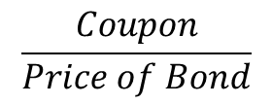
Current Yield
A bond’s annual coupon divided by its price
$$\frac{Coupon}{Price of Bond}$$

Slide 15
Bond Concepts (continued)
(1) Bond prices and market interest rates move in opposite directions.
(2) When coupon rate = YTM, price = par value.
When coupon rate > YTM, price > par value (premium bond)
When coupon rate < YTM, price < par value (discount bond)
(3) A bond with longer maturity has higher relative (%) price change than one with shorter maturity when interest rate (YTM) changes. All other features are identical.
(4) A lower coupon bond has a higher relative price change than a higher coupon bond when YTM changes. All other features are identical.

Slide 16
YTM and Bond Value
$1400
When the YTM < coupon, the bond trades at a premium.
1300
Bond Value
1200
When the YTM = coupon, the bond trades at par.
1100
1000
800
0
0.01
0.02
0.03
0.04
0.05
0.06
0.07
0.08
0.09
0.1
6 3/8
Discount Rate
When the YTM > coupon (or coupon<YTM), the bond trades at a discount.

Slide 17
Maturity and Bond Price Volatility
Consider two otherwise identical bonds.
The long-maturity bond will have much more volatility with respect to changes in the discount rate
Bond Value
Par
Short Maturity Bond
C%
Discount Rate
Long Maturity Bond

Slide 18
Example
Two bonds with coupon rate 10%, trading at par. One has 1 year to maturity, the other has 10 years to maturity. Interest rate increases to 12%, what will be the prices of two bonds?
PV=1,100/1.12 =982.14
PV=100*[1/0.12-(1/(.12*(1.12)¹⁰)] + 1000/(1.12)¹⁰ =886.99
First bond’s price decreased by 1.79%
Second bond’s price decreased by 11.3%

Slide 19
Coupon Rate and Bond Price Volatility
Consider two otherwise identical bonds.
The low-coupon bond will have much more volatility with respect to changes in the discount rate
Bond Value
High Coupon Bond
Discount Rate
Low Coupon Bond

Slide 20
Example
Two bonds with maturity five years. One has 10% coupon , the other has 20% coupon. Interest rate increases to 12% from 10%, what will be the prices of two bonds?
First bond’s price was $1,000, now it is $928; a decrease of 7.3%.
Second bond’s price was $1,379, now it is $1,288; a decrease of 6.57%.

Slide 21
Bonds’ Features
Interest versus Dividends:
Debt is not an ownership interest in the firm. Creditors do not usually have voting power.
The corporation’s payment of interest on debt is considered a cost of doing business and is fully tax-deductible.
Dividends are paid out of after-tax dollars.
Unpaid debt is a liability of the firm. If it is not paid, the creditors can legally claim the assets of the firm. So, one of the costs of issuing debt is the possibility of financial failure.

Slide 22
Bonds’ Features
Debt or Equity?
Some securities blur the line between debt and equity.
Corporations are very adept at creating hybrid securities that look like equity but are called debt.
Obviously, the distinction is important at tax time.
A corporation that succeeds is creating a debt security that is really equity obtains the tax benefits of debt while eliminating its bankruptcy costs.

Slide 23
Bonds’ Features
Debt or Equity?
For example, suppose a 50 year bond is issued with interest payable solely from corporate income if and only if it is earned, and repayment is subordinate to all other debts of the business.
Surplus notes: These are bonds for which the interest payments need to be made only if the firm is profitable. If it is not, the interest payments are cumulated and paid in subsequent periods.
Insurance companies are among the heaviest users of surplus notes, since they are considered debt for tax purpose and equity under insurance accounting rules (financial service firms have to maintain equity capital ratios that exceed regulatory minimums).

Slide 24
Long-Term Debt: The Basics
The bond indenture (legal document) usually lists
Amount of Issue, Date of Issue, Maturity
Denomination (Par value)
Annual Coupon, Dates of Coupon Payments
Security
Sinking Funds
Call Provisions
Covenants
Features that may change over time
Rating
Yield-to-Maturity
Market price

Slide 25
Indenture
The written agreement between the corporate debt issuer and the lender.
Sets forth the terms of the loan:
Maturity
Interest rate
Protective covenants

Slide 26
Different Types of Bonds
A debenture is an unsecured corporate debt, whereas a bond is secured by a mortgage on the corporate property.
In common usage bond is used indiscriminately and often refers to both secured and unsecured debt.

Slide 27
Seniority
Seniority indicates preference in position over other lenders.
Some debt is subordinated. In the event of default, holders of subordinated debt must give preference to other specified creditors who are paid first.
Subordinated debtholders will be paid only after the specified creditors have been compensated.
Debt cannot be subordinated to equity.

Slide 28
Repayment
Long-term debt is typically repaid in regular amounts over the life of the debt. The payment of long-term debt by installments is called amortization.
Amortization is usually arranged by a sinking fund. Each year the corporation places money into a sinking fund, and the money is used to buy back the bonds.

Slide 29
Protective Covenants
A part of indenture limiting certain actions that might be taken during the term of the loan, usually to protect the lender’s interest.
Negative covenant: Thou shalt not:
Pay dividends beyond specified amount. (prevent transfer of assets to shareholders)
Sell or lease the assets without the approval of the lender. (prevent transfer of assets to shareholders)
Sell more senior debt & issue more than a certain amount of new debt. (restricts the dilution of claim of existing bondholders)
Positive covenant: Thou shall:
Use proceeds from sale of assets for other assets.
Maintain certain interest coverage ratio. (to prevent distortion in investment that lead to increases in risk)
Maintain good condition of assets.
Provide audited financial information.

Slide 30
Bond Ratings
Firms frequently pay to have their debt rated.
Debt ratings are an assessment of the creditworthiness of the corporate issuer.
Creditworthiness: How likely is it for the firm to default? What kind of protections do the creditors have in case of a default?
Bond ratings reflect default risk.
There are three major credit rating agencies (S&P, Moody’s, and Fitch). Their total market share is 95%.
These firms are considered by SEC “Nationally Recognized Statistical Rating Organizations.”
http://www.sec.gov/answers/nrsro.htm

Slide 31
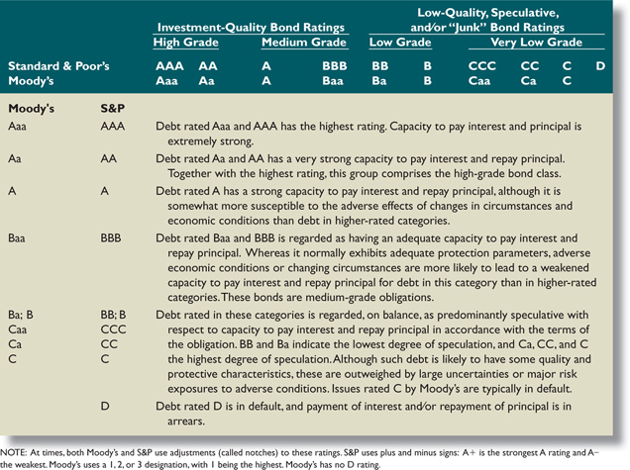
Bond Ratings

Slide 32
Inflation and Interest rates
The nominal rate on an investment is the percentage change in the number of dollars you have.
The real rate on an investment is the percentage change in how much you can buy with your dollars (percentage change in your purchasing power).
Consider the relationship between interest rates and inflation, often referred to as the Fisher relationship:
(1 + Nominal Rate) = (1 + Real Rate) × (1 + Inflation Rate)
For low rates of inflation, this is often approximated as
Real Rate ≅ Nominal Rate – Inflation Rate

Slide 33
Factor Affecting Required Rate of Return
Required Return
on the investment
=
Real Rate
of Return
+
Inflation Premium
+
Risk Premium
The rate of return that could be
earned in a perfect world
where all outcomes were known
and certain-where there
was no risk.
The average rate of inflation expected in the future.
A return premium that reflects the issue and issuer characteristic as associated with a given investment vehicle.
Risk Free Rate

Slide 34
Factor Affecting Required Rate of Return
Real rate
Inflation premium
Interest rate risk premium
Default risk premium
Taxability premium
Liquidity premium – bonds that have more frequent trading will generally have lower required returns
Anything else that affects the risk of the cash flows to the bondholders will affect the required returns.

Slide 35
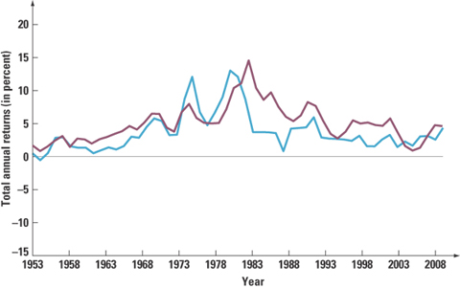
One-year T-Bonds yields and Inflation

Slide 36
Determinants of Bond Yields
Term structure is the relationship between time to maturity and yields, all else equal.
It is important to recognize that we pull out the effect of default risk, different coupons, etc.
Yield curve – graphical representation of the term structure
Normal – upward-sloping, long-term yields are higher than short-term yields
Inverted – downward-sloping, long-term yields are lower than short-term yields

Slide 37
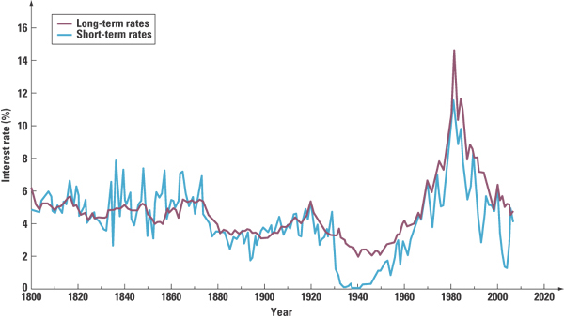
US Interest Rates

Slide 38
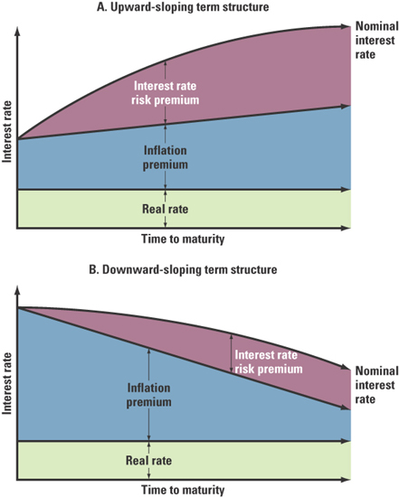
Term-Structure of Interest Rates
http://www.treasury.gov/resource-center/data-chart-center/interest-rates/Pages/Historic-Yield-Data-Visualization.aspx

Slide 39
Summary and Conclusion
In this chapter, we used the time value of money formulae from previous chapters to value bonds.
The value of a zero-coupon bond is

Slide 40
Summary and Conclusion
2. The value of a coupon bond is the sum of the PV of the annuity of coupon payments plus the PV of the par value at maturity.
3. The yield to maturity (YTM) of a bond is that single rate that discounts the payments on the bond to the purchase price.

