Slide 1
Financial Statements and Cash Flows
Notes:
Investors love earning a great rate of return and that's clear they don't like risk uncertainty. -The chance of losing a large portion of their money.
We said risk and return are the two most important dimensions in investment decision making.
Therefore it is easy to understand why we must spend a good portion of time to learn how to measure and forecast a security risk.

Slide 2
Why are financial statements important?
Significant information about a company’s financial health.
This, in turn helps to evaluate company’s financial performance
Who uses this information?
Investors (or shareholders), creditors, and analysts.
Managers, employees, government.
In other words => Valuation +Evaluation
Financial Statements and Cash Flows

Slide 3
Source of Information
Annual Reports
Wall Street Journal
Internet:
NYSE (www.nyse.com)
NASDAQ (www.nasdaq.com)
Yahoo/Google Finance
Morningstar (www.morningstar.com)
SEC-EDGAR
Financial Statements and Cash Flows

Slide 4
Financial Statements
(1) Balance Sheet
(2) Income Statement
Financial Statements and Cash Flows

Slide 5
Financial Statements-Balance Sheet (B/S)
(1) Balance Sheet
It reports a company’s assets, liabilities, and shareholder equity at a specific point in time
Assets = Liabilities + Shareholder’s Equity
Nike, Inc. (NKE)
https://finance.yahoo.com/quote/NKE/balance-sheet?p=NKE
Financial Statements and Cash Flows

Slide 6
Example 1) U.S. Corporation Balance Sheet
U.S. CORPORATION
Balance Sheets as of December 31, 2018 and 2019
($ in Millions)
 | 2018 | 2019 |  | 2018 | 2019
 | Assets |  | Liabilities and Owners’ Equity
Current Assets |  |  | Current liabilities
Cash | $ 104 | $ 160 | Accounts payable | $ 232 | $ 266
Accounts Receivable | 455 | 688 | Notes payable | 196 | 123
Inventory | 553 | 555 | Total | $ 428 | $ 389
Total | $ 1,112 | $ 1,403
Fixed assets
Net fixed assets | $ 1,644 | $ 1,709 | Long-term debt | $ 408 | $ 454
 |  |  | Owners’ equity
 |  |  | Common stock and paid-in surplus | 600 | 640
 |  |  | Retained earnings | 1,320 | 1,629
 |  |  | Total | $1,920 | $2,269
Total assets | $ 2,756 | $ 3,112 | Total liabilities & owners’ equity | $2,756 | $3,112
Financial Statements and Cash Flows

Slide 7
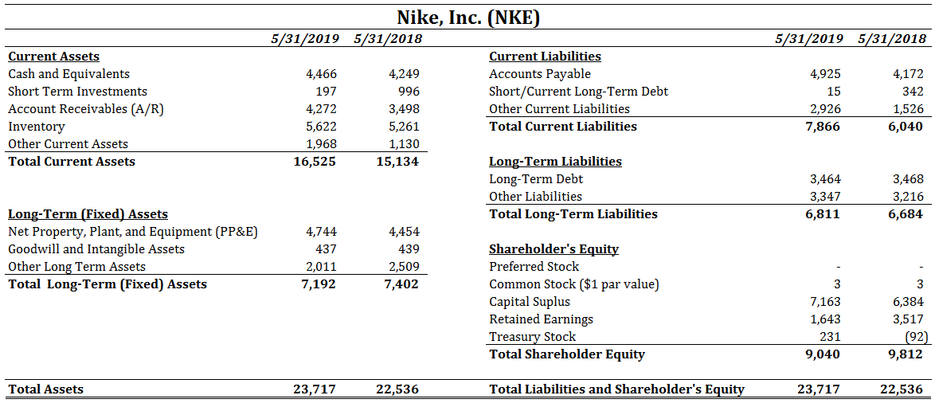
Example 2) Nike, Inc. Balance Sheet
Financial Statements and Cash Flows

Slide 8
Important Rules in B/S
The assets are listed in order by the length of time it would normally take a firm with ongoing operations to convert them into cash.
Clearly, cash is more liquid than property, plant, and equipment.
Liquidity:
It refers to the ease and quickness with which assets can be converted to cash – without a significant loss in value.
Current assets are the most liquid.
The more liquid a firm’s assets, the less likely the firm is to experience problems meeting short-term obligations.
Liquid assets frequently have lower rates of return than fixed assets
Some fixed assets are intangible.
Debt versus Equity:
Creditors generally receive the first claim on the firm’s cash flow.
Shareholder’s equity is the residual difference between assets and liabilities.
Value versus Cost
Under Generally Accepted Accounting Principles (GAAP), audited financial statements of firms in U.S. carry assets at cost, i.e., historical cost. The numbers in B/S are called “Book Value.”
“Market Value” is the price at which the assets, liabilities, ad equity could actually be bought or sold.
Market Value and Book Value are completely different.
Financial Statements and Cash Flows

Slide 9
Financial Statements-Income Statement(I/S)
(2) Income Statement
It measures financial performance over a specific period of time.
Three important parts:
(i) Operations
(ii) Non-operating (financing)
(iii) Taxes
Nike, Inc. (NKE)
https://finance.yahoo.com/quote/NKE/financials?p=NKE
Financial Statements and Cash Flows

Slide 10
Example 3) U.S. Corporation Income Statement
U.S. CORPORATION
2019 Income Statement
($ in Millions)
Net Sales |  | $1,509
Cost of goods sold |  | 750
Depreciation |  | 89
Earnings before interest and taxes |  | $ 670
Interest paid |  | 70
Taxable income |  | $ 600
Taxes (21%) |  | 126
Net income |  | $ 474
Dividends | $165
Addition to retained earnings | 309
Financial Statements and Cash Flows

Slide 11
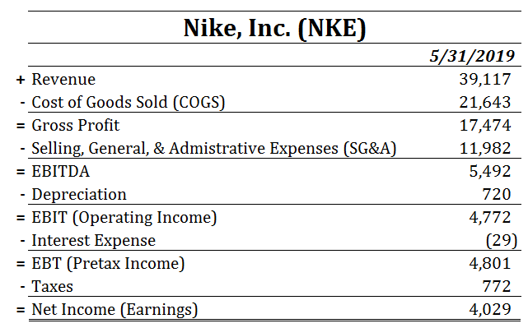
Example 4) Nike, Inc. Income Statement
Financial Statements and Cash Flows

Slide 12
Let’s dissect the I/S
I/S is one of mostly used financial statement by investors and analysts.
Have a closer look at it!
Financial Statements and Cash Flows

Slide 13
Nike, Inc. Income Statement-Operations
The operations section of I/S reports the firm’s revenues and expenses from principal operations
Financial Statements and Cash Flows

Slide 14
Nike, Inc. Income Statement-Non-Operating (Financial)
The non-operating section of the I/S includes all financing costs (revenues), such as interest expense
Financial Statements and Cash Flows

Slide 15
Nike, Inc. Income Statement-Taxes
Usually a separate section reports the amount of taxes levied on income
Financial Statements and Cash Flows

Slide 16
Nike, Inc. Income Statement-Net Income
Net Income (Earnings) is the “Bottom Line” item
Financial Statements and Cash Flows

Slide 17
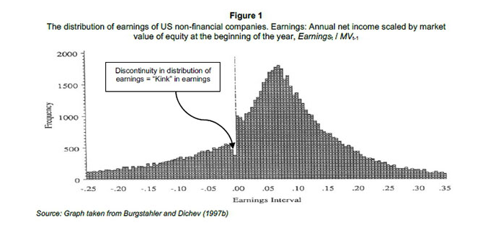
Discussion: How important is the I/S?
Earnings:
“excessive emphasis being laid on the reported earnings -- which might only be temporary or even deceptive.” Benjamin Graham
Financial Statements and Cash Flows

Slide 18
Discussion: How important is the I/S?
Gross Profitability
https://www.wsj.com/articles/SB10001424127887323293704578334491900368844
https://www.sciencedirect.com/science/article/pii/S0304405X13000044
Trend in Gross Profitability
https://www.aaajournals.org/doi/abs/10.2308/accr-51708
Operating Profitability
https://www.sciencedirect.com/science/article/pii/S0304405X15000203
Financial Statements and Cash Flows

Slide 19
Important Rules in I/S
GAAP:
The matching principle of GAAP dictates that revenues be matched with expenses.
Thus, income is reported when it is earned, even though no cash flow may have occurred.
Non-Cash Items
Depreciation is the most apparent. No firm ever writes a check for “depreciation.”
Another non-cash item is deferred taxes, which does not represent a cash flow.
Thus, net income is not cash.
Financial Statements and Cash Flows

Slide 20
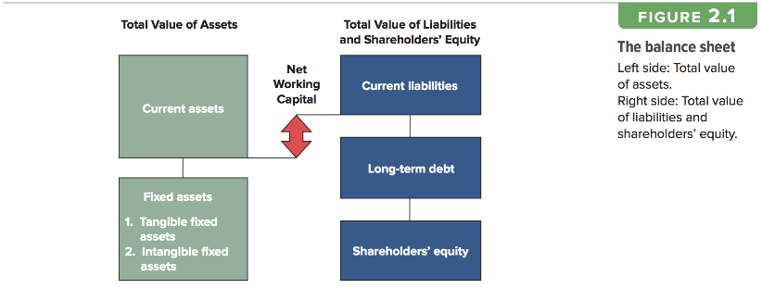
One more concept: Working Capital
Working Capital (WC):
Capital (or money) required for firm to do daily business activities
Working Capital= Current Assets – Current Liabilities
Working Capital grows with the firm.
Change in Working Capital (ΔWC)
$∆{WC}_{t}={WC}_{t}−{WC}_{t−1}$
Financial Statements and Cash Flows

Slide 21
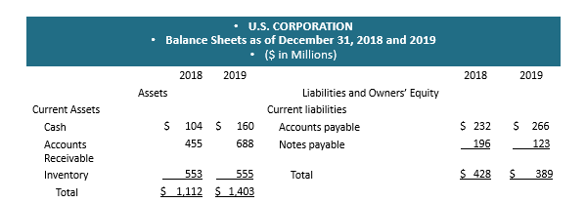
Example 5) U.S. Corporation-Working Capital
WC(2018)= CA(2018) - CL(2018)
= 1,112 - 428
= 684
WC(2019)= CA(2019) - CL(2019)
= 1,403 - 389
= 1,014
ΔWC(2019)= WC(2019) - WC(2018)
= 1,104 - 684
= 330
This increase of $330 million is NOT available to shareholders
Financial Statements and Cash Flows

Slide 22
Example 6) Nike, Inc.-Working Capital
WC(2019)= CA(2019) - CL(2019)
= 16,525 - 7,866
= 8,659
WC(2018)= CA(2018) - CL(2018)
= 15,134 - 6,040
= 9,094
ΔWC(2019)= WC(2019) - WC(2018)
= 8,659 - 9,094
= -435
This decrease of $435 million is available to shareholders
Financial Statements and Cash Flows

Slide 23
CASH FLOW
Now! It is time to use what we have learned so far to value the firm
Cash flow = one of the most important pieces of information that can be derived from financial statements.
Our focus: how cash is generated from utilizing assets and how it is paid to those who finance the asset purchase.
Financial Statements and Cash Flows

Slide 24
Cash Flow from Asset/Operating Free Cash Flows
How much cash generated by the corporation?
At the end, this is what we, as investors, are really interested in.
IMPORTANT!
I, sometimes, use a bit different terminology from the book.
Financial Statements and Cash Flows

Slide 25
Cash Flow from Asset/Operating Free Cash Flows
Operating Free Cash Flows (OFCF) or Cash Flow from Asset (CFFA)
This is the cash flows generated by a company’s operating activities and available to all who provided capital to the firm (Debt and Equity Holders).
To value the whole firm and Capital Investments (later in the class)
$OFCF\left(CFFA\right)=EBIT+Dep.−Taxes − CAPEX(NCS) − ∆WC$ ($∆NWC)$
$$EBITDA$$
$$Change in LT Assets$$
$$Change in WC$$
$$Operating Cash Flows (OCF)$$
Financial Statements and Cash Flows

Slide 26
Example 7) OFCF or CFFA of U.S. Corporation
Balance Sheet
U.S Corporation
Assets |  |  | Liabilities & Owners’ Equity
 | 2018 | 2019 |  | 2018 | 2019
Current Assets |  |  | Current Liabilities
Cash | $ 104 | $ 160 | Accounts Payable | $ 232 | $266
Accounts Receivable | 455 | 688 | Notes Payable | 196 | 123
Inventory | 553 | 555 | Total | $ 428 | $389
Total | $1,112 | $1,403 | Long-term debt | $ 408 | $454
Fixed Assets |  |  | Owners' Equity
Net Fixed assets | $1,644 | $1,709 | Common Stock and paid in surplus | 600 | 640
 |  |  | Retained Earnings | 1,320 | 1,629
 |  |  | Total | $1,920 | $2,269
Total Assets | $2,756 | $3,112 | Total Liabilities & Owners' Equity | $2,756 | $3,112
Income Statement
Net sales |  | $ 1,509
Cost of goods sold |  | 750
Depreciation |  | 89
Earnings before interest and taxes |  | $ 670
Interest paid |  | 70
Taxable Income |  | $ 600
Taxes (21%) |  | 126
Net Income |  | $ 474
Dividends | $165
Addition to retained earnings | $309
OCF = EBIT + Depreciation - taxes
EBIT = 670
Depreciation = 89
Taxes = 126
OCF=670+89-126=633
OFCF (CFFA) = OCF – CAPEX (NCS) - ΔWC
OCF=633
CAPEX=LT Asset (2019) – LT Assets (2018) + Depreciation = 1709 – 1644 +89 = 154
ΔWC=WC(2019) – WC(2018) = 330
OFCF (CFFA) = 633 – 154 – (330) = 149

Slide 27
Example 8) OFCF or CFFA of Nike
OCF
EBIT = 4,772
Depreciation = 720
Taxes = 772
OCF=4,772+720-772=4,720
OFCF
OCF=4,720
CAPEX=LT Asset (2019) – LT Assets (2018) + Depreciation = 7,192 – 7,402 + 720 = 510
ΔWC=WC(2019) – WC(2018) = -435
OFCF (CFFA) = 4,720 – 510 – (-435) = 4,645
Financial Statements and Cash Flows

Slide 28
Thanks!

