Slide 1
Interest Rate and Bond Valuation
Questions

Slide 2
Question (1)
Microhard has issued a bond with the following characteristics:
Par=$1,000
Time to Maturity: 13 years
Coupon Rate:8%
Semiannual payments
Calculate the price of this bond if the YTM is:
8%
10%
6%
Bond Valuation

Slide 3
Answer
a.
FV=1000 N=26 PMT=40 I/Y=4
=> PV=1000 b.
FV=1000 N=26 PMT=40 I/Y=5
=>PV=856 c.
FV=1000 N=26 PMT=40 I/Y=3
=>PV=1178
Bond Valuation

Slide 4
Question (2)
Watters Umbrella Corp. issued 15-year bonds 2 years ago at a coupon rate of 7 percent. The bonds make semiannual payments. If these bonds currently sell for 90 percent of par value, what is the YTM?
Bond Valuation
Notes:
N=30 PV=-900 PMT=35 FV=1000 => I/Y=4.08 => YTM=4.08x2=8.06%

Slide 5
Answer
N=13x2=26
PV=-900
PMT=(1000 x 0.07)/2=35
FV=1000
=> I/Y=4.13 => YTM=4.13x2=8.26%
Bond Valuation

Slide 6
Question (3)
Rhiannon Corporation has bonds on the market with 14.5 years to maturity, a YTM of 7.5 percent, and a current price of $1,061. The bonds make semiannual payments.
What must be the coupon rate on these bonds?
Bond Valuation
Notes:
Here we need to find the coupon rate of the bond. All we need to do is to set up the bond pricing equation and solve for the coupon payment as follows:
P = $1,061 = C(PVIFA_{3.75%,29}) + $1,000(PVIF_{3.75%,29})
Solving for the coupon payment, we get:
C = $40.99
Since this is the semiannual payment, the annual coupon payment is:
2 × $40.99 = $81.97
And the coupon rate is the annual coupon payment divided by par value, so:
Coupon rate = $81.97 / $1,000Coupon rate = .0820, or 8.20%

Slide 7
Answer
N= 14.5 x 2 = 29
YTM= 7.5/2=3.75 (Semi-annual)
PV=-1061
FV=1000
PMT=41 (semi-annual) or 41x2=82 (Annual)
Coupon Rate = 82/1000= 8.2%
Bond Valuation

Slide 8
Question (4)
The Faulk Corp. has a 4 percent coupon bond outstanding. The Gonas Company has a 10 percent bond outstanding. Both bonds have 13 years to maturity, make semiannual payments, and have a YTM of 7 percent.
If interest rates suddenly rise by 2 percent, what is the percentage change in the price of these bonds?
Bond Valuation

Slide 9
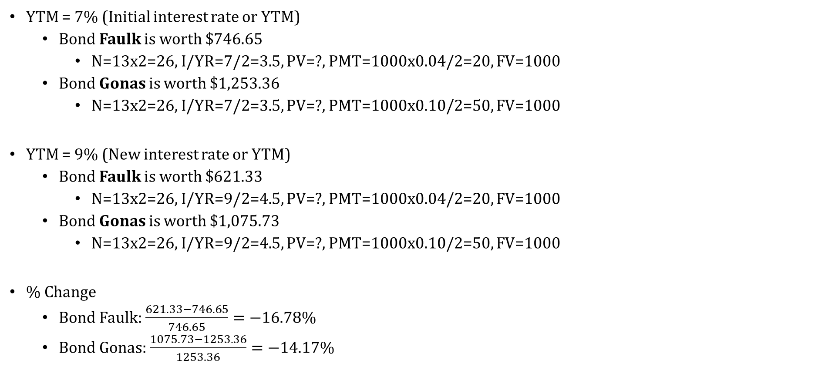
Answer
YTM = 7% (Initial interest rate or YTM)
Bond Faulk is worth $746.65
N=13x2=26, I/YR=7/2=3.5, PV=?, PMT=1000x0.04/2=20, FV=1000
Bond Gonas is worth $1,253.36
N=13x2=26, I/YR=7/2=3.5, PV=?, PMT=1000x0.10/2=50, FV=1000
YTM = 9% (New interest rate or YTM)
Bond Faulk is worth $621.33
N=13x2=26, I/YR=9/2=4.5, PV=?, PMT=1000x0.04/2=20, FV=1000
Bond Gonas is worth $1,075.73
N=13x2=26, I/YR=9/2=4.5, PV=?, PMT=1000x0.10/2=50, FV=1000
% Change
Bond Faulk: $\frac{621.33−746.65}{746.65}=−16.78\%$
Bond Gonas: $\frac{1075.73−1253.36}{1253.36}=−14.17\%$
Bond Valuation

Slide 10
Question (5)
Hacker Software has 9.8 percent coupon bonds on the market with 18 years to maturity. The bonds make semiannual payments and currently sell for 107.7 percent of par.
What is the current yield on the bonds?
What is the YTM?
What is the effective annual yield?
Bond Valuation
Notes:
The bond price equation for this bond is:
P₀ = $1,077 = $49(PVIFA_{R%,36}) + $1,000(PVIF_{R%,36})
Using a spreadsheet, financial calculator, or trial and error we find:
R = 4.466%
This is the semiannual interest rate, so the YTM is:
YTM = 2 × 4.466%
YTM = 8.93% The current yield is: Current yield = Annual coupon payment / PriceCurrent yield = $98 / $1,077Current yield = .0910, or 9.10%
The effective annual yield is the same as the EAR, so using the EAR equation from the previous chapter:
Effective annual yield = (1 + .04466)² – 1Effective annual yield = .0913, or 9.13%

Slide 11
Answer
N=36 PV=-1077 PMT=49 FV=1000 => I/Y=4.47 (Semi-Annual)
=> YTM = 4.47 x 2 = 8.94
Current yield = Annual coupon payment / Price
Current yield = $98 / $1,077 = .0910, or 9.10%
Effective annual yield = (1 + .04466)² – 1Effective annual yield = .0913, or 9.13%
Bond Valuation

Slide 12
Thanks!

