Slide 1
Risk and Return – Part (II)

Slide 2
Decomposing Return
Total return = Expected return + Unexpected return
Expected return
It is based on the market’s understanding today of important factors that will influence the stock in the future
Unexpected return
It is the risky part coming from unexpected information revealed in the future
Risk and Return - II
Notes:
Apple average quarterly return is 8.6% from 2010 to 2014
Investors would expect Apple quarterly return will be 8.6% in 2015
However, Apple’s realized total return from Nov 2014 to Feb 2015 was 8.4%, 8.4% = 8.6% + (-0.2%)
What does -0.2% mean? Why total return is -0.2% different from the average?

Slide 3
Understanding the components of return
Stock prices (as a result, return) is determined by the new information
Source of new information???
Announcement: the release of information not previously available.
Risk and Return - II

Slide 4
Announcement and News
Announcement = Predicted part + Surprise
Predicted part
The information that the market uses to form the expectation of the return on the stock
Discounted information is information that is already included in the expected return (and the price).
Surprise
The news that influences the unanticipated return on the stock
Risk and Return - II

Slide 5
Predicted Part
GDP growth rate is one important factor that can affect almost every stock in the capital market
Before the government announces GDP figures, the whole market will have a prediction of GDP growth
The effect of this prediction on stock return is reflected in its expected return and current price
Risk and Return - II

Slide 6
Surprises
Possible sources:
Government figures released on gross domestic product (GDP) different from prediction
A sudden, unexpected drop in interest rate
News research projects
Sales figure are higher than that expected
Unexpected release of new product by competitors
Risk and Return - II
Notes:
(1) On August 9, 2000, it was announced that Eli-Lilly’s Prozac patent would not be extended, overturning a lower court decision. This was unexpected and the price dropped from $108.531 to $76.875 (a 29% drop) in one day. (2) On September 22, 2000, Intel issued an earnings warning, and its stock price dropped from $61.468 to $47.937 (a 22% drop) in one day. (3) On September 30, 2004, Merck announced a voluntary recall of its arthritis and acute pain medication VIOXX following a reported increased incidence of cardiovascular events.

Slide 7
Component of Risk
If we can decompose return, then we can decompose risk.
Total Risk = Systematic risk + Unsystematic risk
Systematic risk (Market risk)
Fluctuations that are due to market-wide news
Systematic risk affects a large number of assets
Unsystematic risk (Asset-specific risk)
Fluctuations that are due to firm-specific news
Unsystematic risk affects a limited number of assets
Risk and Return - II

Slide 8
Examples of Two Types of Risk
Systematic risk
Oil price rise, increasing production costs
The economy slows, reducing demand for the firm’s products
Unsystematic risk
The founder and CEO retires
A product design is faulty and the product must be recalled
Risk and Return - II

Slide 9
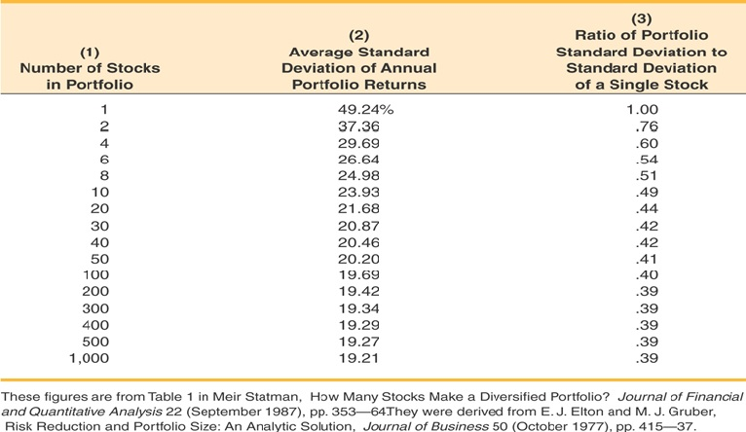
What happens to Risk in a portfolio?
Risk and Return - II

Slide 10
Principle of Diversification
Diversification:
The process of spreading an investment across assets and thereby forming portfolios
Principle of diversification
Spreading an investment across many assets will eliminate some of the risk (diversifiable risk)
There is a minimum level of risk (non-diversifiable risk) that cannot be eliminated simply by diversifying
Risk and Return - II

Slide 11
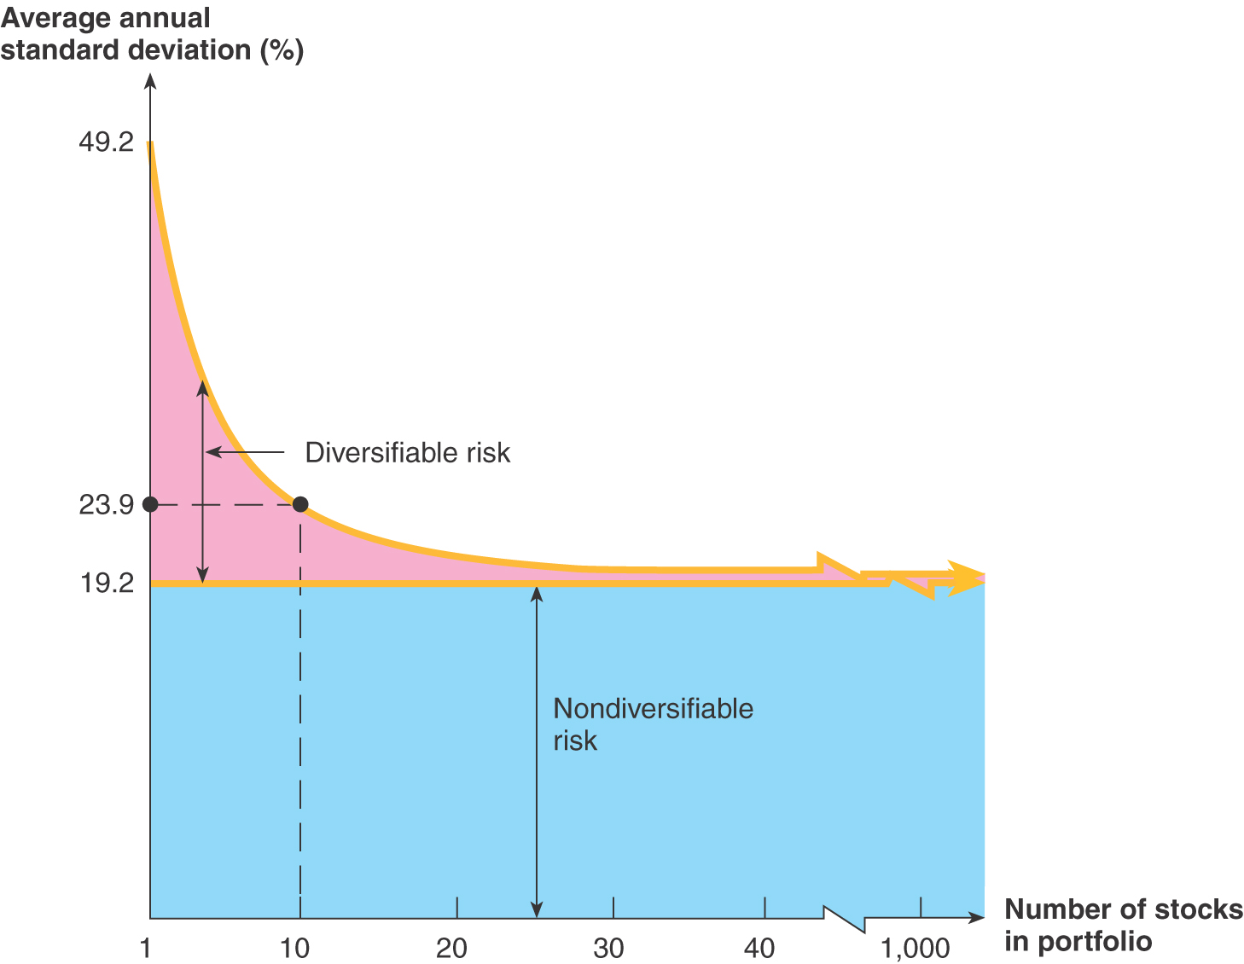
Total Risk – Numbers of Stock
Risk and Return - II

Slide 12
Specifically
The riskiness associated with individual assets (unsystematic risk) can be eliminated by forming portfolios
Why forming a portfolio can reduce unsystematic risk but not systematic?
The amount of risk that is eliminated in a portfolio depends on the degree to which the stock returns move together.
Systematic risk controls the co-movement across all stocks. All stocks tend to perform well when good market-wide news comes.
Unsystematic risk only affect the co-movement among several stocks, which can be eliminate as number of stock increases.
Risk and Return - II

Slide 13
Diversifiable Risk
Why some risk can be diversified away but some cannot?
If we hold a large portfolio, some of stocks will go up in value because of positive firm-specific events and some will go down because of negative events
The net effect on the overall value will be relatively small as these opposite effects will tend to cancel out each other
Unsystematic risk can be eliminated by diversification, so diversifiable risk is essentially the unsystematic risk
A relatively large portfolio has no unsystematic risk
Risk and Return - II

Slide 14
Non-diversifiable Risk
Marketwise news cause almost all the stock prices move in the same direction, so the net effect of market risk will be great
Systematic risk cannot be eliminated by diversification, so non-diversifiable risk is essentially the systematic risk
A relatively large portfolio only has systematic risk
Systematic risk principle
The reward for bearing risk depends only on the systematic risk of an investment
Risk and Return - II

Slide 15
Market Portfolio
A portfolio of all stocks and securities traded in the capital markets
Market portfolio has only systematic risk
In practice, S&P 500 is used as the approximation for market portfolio.
Risk and Return - II

Slide 16
Bottom Line
IF MARKET PORTOFLIO HAS ONLY SYSTEMATIC RISK, AND I HOLD A STOCK IN A WELL-DIVERSIFIED PORTFOLIO:
I CAN ELIMINATE UNSYSTEMATIC (FIRM SPECIFIC RISK)
THEN WHAT MATTERS TO INVESTORS IS HOW SENSITIVE MY STOCK TO SYSTEMATIC RISK (i.e., market wide risk)
Risk and Return - II

Slide 17
How to measure Systematic Risk
Benchmark measure of systematic risk: Market portfolio’s standard deviation
An asset’s Beta measures its systematic risk
Beta is a relative measure: How much systematic risk this asset has relatively to the market portfolio
A market portfolio has a beta of 1
An asset with a beta of 0.5 has half as much as systematic risk as market portfolio
An asset with a beta of 2 has twice as much as systematic risk as market portfolio
Risk and Return - II

Slide 18
Beta for Selected Individual Stocks
Company | Industry | Beta
Consolidated Edison | Utilities | 0.08
Hershey | Food Processing | 0.64
General Mills | Food Processing | 0.73
eBay | Internet Service | 0.79
Intel | Semiconductors | 0.90
Apple | Computer Hardware | 0.96
Google | Internet Service | 1.07
Salesforce.com | Application Software | 1.30
Tiffany & Co. | Specialty Stores | 2.15
American Airline | Major Airlines | 3.85
Risk and Return - II

Slide 19
Total Risk vs. Beta
Consider the following information:
Standard Deviation Beta
Cisco 20% 1.43
Amgen 40% 0.58
Which stock has more systematic risk?
Which stock has more total risk?
Risk and Return - II

Slide 20
Portfolio Beta
$$β_{p}=W_{1}β_{1}+W_{2}β_{2}+…+W_{n}β_{n}$$
$W_{n}=$ Weight of stock $n$ (Fraction of $ invested in stock $n$ )
$β_{n}=$ Beta of stock $n$
$β_{p}=$ Portfolio Beta
Risk and Return - II

Slide 21
Example 1
Suppose we had following investments:
What is the beta of this portfolio?
Does this portfolio have more or less systematic risk than the market portfolio?
Security | Amount Invested | Beta
Stock A | 1,000 | 0.80
Stock B | 2,000 | 0.95
Stock C | 3,000 | 1.10
Stock D | 4,000 | 1.40
Risk and Return - II

Slide 22
Solution
Risk and Return - II

Slide 23
Example 2
You own a portfolio equally invested in a risk-free asset and two stocks. One of the stocks has a beta of 1.29 and the total portfolio is equally as risky as the market. What must the beta be for the other stock in your portfolio?
Risk and Return - II

Slide 24
Solution
βp = 1.0 = 1/3(0) + 1/3(1.29) + 1/3(βX)
βX = 1.71
Risk and Return - II

Slide 25
Risk Premium
Additional return investors earn by moving from a risk-free investment to a risky one
Risk premium = Expected Return – Risk-free rate
Risk-free rate is the return from risk-free assets
In practice, the return from Treasury bills is used as the approximation for risk-free rate
The reward for bearing systematic risk
Risk and Return - II

Slide 26
Market Risk Premium
Risk premium of market portfolio
Difference between market portfolio expected return and risk-free rate
Risk premium investors earn by bearing one unit systematic risk
Reward for bearing one unit systematic risk
Risk and Return - II

Slide 27
Risk Premium and Beta
The return of large-company portfolio is essentially the return of S&P 500 index (proxy for market portfolio), so $8\%−3\%=5\%$ market premium can be view as the reward to bear one unit systematic risk
If a stock has a beta of 2, how much risk premium should be awarded to investors who hold it?
This stock has 2 units systematic risk
Investor would expect 10% risk premium, why?
Risk and Return - II

Slide 28
Capital Asset Pricing Model
The CAPM defines the equilibrium relationship between risk premium, market risk premium, and beta
$$E\left(R_{i}\right)−R_{f}=β_{i}\left[E\left(R_{m}\right)−R_{f}\right]$$
$E\left(R_{i}\right)$: expected return of risky asset $i$
$β_{i}$: beta of risk asset $i$
$E\left(R_{m}\right)$: market portfolio’s expected return
$R_{f}$: risk-free interest rate
Risk and Return - II

Slide 29
Example 3
A stock has a beta of 1.13, the expected return on the market is 10.7%, and the risk-free rate is 4.6%. What must the expected return on this stock be?
Risk and Return - II

Slide 30
Solution
E(Ri) = .0460 + (.1070 – .0460)(1.13) = .1149, or 11.49%
Risk and Return - II

Slide 31
Reward-to-Risk Ratio
Reward-to-Risk Ratio
$$\frac{E\left[R_{i}\right]−R_{f}}{β_{i}}$$
$E\left[R_{i}\right]$ = Risky asset i’s expected return
$R_{f}$ = Return from riskless assets
$β_{i}$ = Risky asset i’s beta
In a well-organized, active market, the reward-to-risk ratio should be the same across all risky assets in equilibrium
In a well-organized, active market, the reward-to-risk ratio should be the same as market risk premium in equilibrium
Risk and Return - II

Slide 32
Example 4
Stock Y has a beta of 1.25 and an expected return of 12.6%. Stock Z has a beta of 0.8 and an expected return of 9.9%.
If the market is now in equilibrium, what would the risk-free rate have to be?
If the risk free rate is 4.1% and market risk premium is 7%, are these stocks correctly priced? Why?
Risk and Return - II

Slide 33

Solution
$\frac{12.6\%−R_{f}}{1.25}=\frac{9.9\%−R_{f}}{0.8}$
$→0.64×\left(12.6\%−R_{f}\right)=9.9\%−R_{f}$
$→8.064\%−{0.64R}_{f}=9.9\%−R_{f}$
$→{0.36R}_{f}=1.836\%$
$→R_{f}=5.1\%$
Risk and Return - II

Slide 34
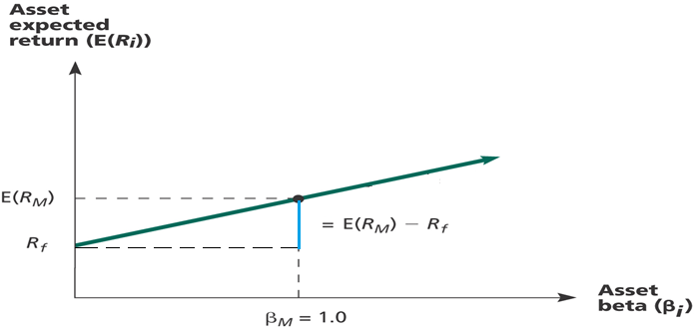
Security Market Line
Risk and Return - II

Slide 35
Example 4
You are examining two stocks – Bassett Inc and Hound Corporation. The risk-free rate is 3% and the return of market portfolio is 8%. The following table provides some information.
According to the CAPM, what is the expected return of the stock of Bassett Inc and Hound Corporation?
What is the actual percent return of the stock of Bassett Inc and Hound Corporation?
Draw the Security Market Line (SML), label axes, identify risk free asset and market portfolio. Identify where Bassett and Hound actually lie on this graph.
If you buy 200 shares of Bassett and 200 shares of Hound and $5,000 in Treasury bills, what would the portfolio beta be?
 |  |  | Next year
 | Beta | Current Price | Dividends (D1) | Price (P1)
Bassett | 1.1 | $25 | $1.00 | $26.13
Hound | 0.8 | $30 | $1.20 | $34.00
CAPM & APT
Notes:
B: 3+1.1*(8-3)=8.5 , H: 3+0.8*(8-3)=7%
B: (26.13+1-25)/25=8.52% , H: (34+1.20-30)/30=17.33%

Slide 36
Solution
B: 3+1.1*(8-3)=8.5 , H: 3+0.8*(8-3)=7%
B: (26.13+1-25)/25=8.52% , H: (34+1.20-30)/30=17.33%
Risk and Return - II

Slide 37
Thanks!

