Slide 1
Mutual Funds and Other Investment Companies

Slide 2
Direct Ownership of Securities
Options for direct ownership of securities include:​
Brokerage account​
Investor has high degree of control.​
Costs vary widely.​
Trust account ​
For high net worth individuals.​
High customer service level.​
Separately managed account (SMA)​
Uses technology to adapt model portfolio selected by an investment professional to an individual account.​
Can be customized to limited extent.
MFs and Other Investment Companies

Slide 3
Mutual Funds
A fund is mutual because​​ all of its returns​ – from interest, dividends, and capital gains – ​and all of its expenses​ are shared by the fund’s investors.
Pros:
Reduction of risk by investment diversification
Ability to sell your investment daily
Access to the expertise of professional money managers
Ability to participate in investment strategies that might not otherwise be available to smaller investors
Administrative convenience and shareholder services
A high level of investor safeguards
Comprehensive reporting that enables easy comparisons among funds
Cons:
Fees
No control on timing of gains (TAX IMPLICATIONS)
Less predictable income
No Customization
MFs and Other Investment Companies

Slide 4
Buying and Selling Fund Shares
Fund
Issues Shares
Investors
The fund issues shares to the public at net asset value (NAV)
Each share represents proportional ownership of fund assets
Each fund is a separate corporation, called a (registered) investment company
Investors put their money into fund by buying shares and becoming fund shareholders
Investors can sell their shares back to the fund at NAV
MFs and Other Investment Companies

Slide 5
Types of Mutual Funds
Fundamentally three varieties of mutual funds:​
Equity funds (stocks)​
Fixed Income funds (bonds)​
Money Market funds
Investment Policies of Mutual Funds
Money Market
Equity, Equity Sector
Bond
Global
International, International Regional
Emerging Market
Balanced, Target
Asset Allocation/Index Funds
Fund of Funds
MFs and Other Investment Companies

Slide 6
Active vs. Passive Funds
MFs and Other Investment Companies

Slide 7
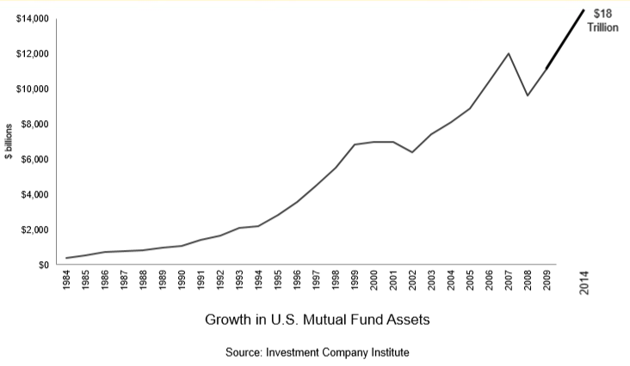
Trends in Mutual Funds
MFs and Other Investment Companies

Slide 8
Valuing Mutual Funds – Net Asset Value
Assets minus Liabilities
Number of Shares outstanding
Net Asset Value (NAV)
NAV is computed at the end of every business day
Investor may sell their shares back to fund (redeem) at the end of every business day
MFs and Other Investment Companies

Slide 9
Fee Structure
Fee Structure | Definition
Operating Expenses | Costs incurred by mutual fund in operating portfolio
Front-end Load | Commission or sales charge paid when purchasing shares
Back-end load | “Exit” fee incurred when shares
12b-1 charges | Annual fees charged by mutual fund to pay for marketing/distribution costs
MFs and Other Investment Companies

Slide 10
How to invest in Mutual Funds
No-load funds: sometimes called No Transaction Fee (NTF) funds — do not charge sales commissions ​
Buy directly from a mutual fund company, like The Vanguard Group or T. Rowe Price​
through an online or discount brokerage, like ING Sharebuilder, E*Trade, Fidelity or Charles Schwab ​
Load funds: pay a sales commission, at the time of purchase or at the time of sale.​
Class A: pay a commission up front​
Class B: no commission at purchase, pay if you sell your shares​
Class C or level load, pay a commission each year
MFs and Other Investment Companies

Slide 11
Example) Fee Structure
Here are fees for different classes of the Dreyfus High Yield Fund in 2017. Notice the trade-off between front-end loads and 12b-1 charges in Class A versus Class C.
 | Class A | Class C | Class I
Front-end load | 4.50%ª | 0 | 0
Back-end load | 0 | 1%^{b} | 0
12b-1 fees | 0.25% | 1.0^{c} | 0
Expense ratio | 0.7% | 0.7% | 0.7%
Notes:
ªDepending on size of investment. Load is lower for investments above $50,000.
^{b}Depending on years until holdings are sold.
^{c}Including annual service fee of 0.25%.
MFs and Other Investment Companies

Slide 12
Mutual Fund Characteristics
Morningstar
www.morningstar.com
Example:
http://www.morningstar.com/funds/xnas/prdsx/quote.html
MFs and Other Investment Companies

Slide 13
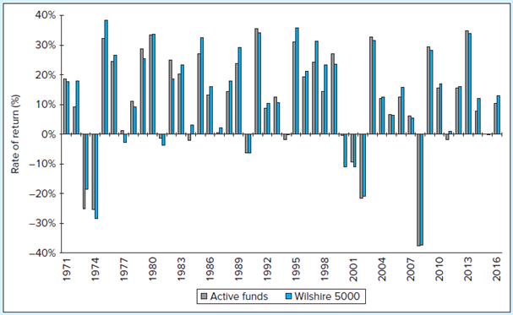
Active Mutual Funds - Performance
Average MF performance < broad market performance
FIGURE 4.4
Rates of return on actively managed equity funds versus Wilshire 5000 Index
MFs and Other Investment Companies

Slide 14
Exchange Traded Funds (ETFs)
Exchange-traded funds​
Shares listed for trading on a stock exchange; price determined by supply and demand.​
Adjust the number of shares outstanding so that the market price remains close to NAV.
Most ETFs are passively managed, though they use a wide variety of indexes.
Are tax-efficient.​
Are growing in popularity.
Some websites:
www.etf.com
https://etfdb.com/etfs/
MFs and Other Investment Companies

Slide 15
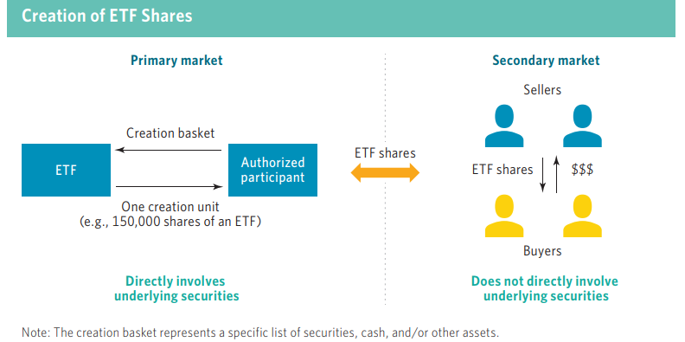
Creation of ETF Shares
MFs and Other Investment Companies

Slide 16
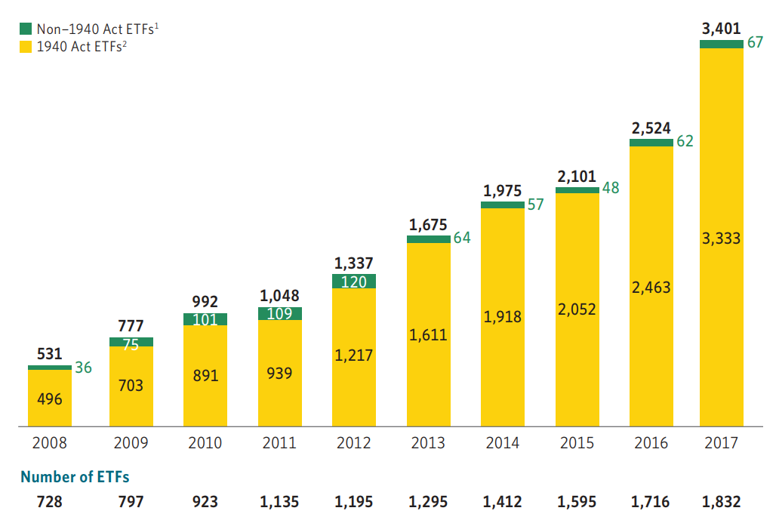
Trends in ETFs
MFs and Other Investment Companies

Slide 17
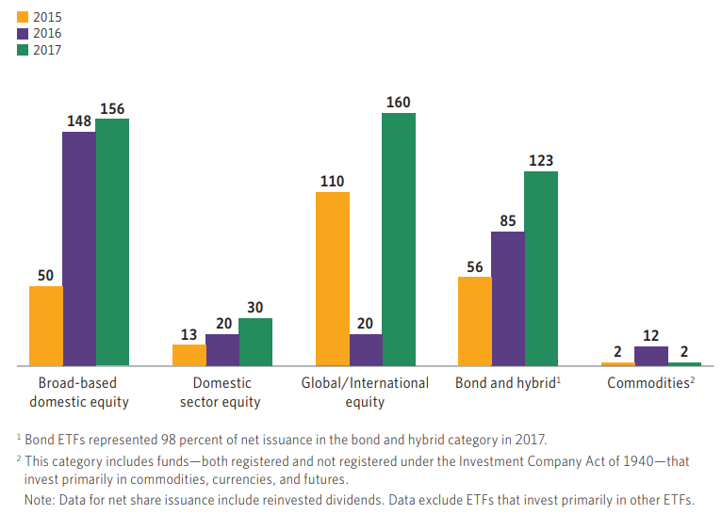
Ne Issuance of ETFs by Investment Classification
MFs and Other Investment Companies

Slide 18
Hedge Funds
Hedge funds are commingled investment vehicles that are not regulated.
They may:
Invest in a wide variety of assets.
Require investors to remain in the fund for long periods.
Use leverage to enhance returns.
Sell securities short extensively.
Charge performance fees based on gains.
. . .though they are not required to do any of these things to be a hedge fund.
MFs and Other Investment Companies

Slide 19
Hedge Fund Strategies - I
Equity long-short
Buy undervalued stocks and sell overvalued stocks short at the same time.
Relative value or arbitrage
Look at the relationship between two securities, and trade when they appear out of line.
Distressed securities
Buy securities of companies near bankruptcy.
Shareholder activism
Buy securities and press for corporate change.
MFs and Other Investment Companies

Slide 20
Hedge Fund Strategies - II
Global macro
Invest based on a macroeconomic outlook.
Managed futures
Trade futures contracts.
Multistrategy
Invest using a range of strategies.
Leverage
Used with many of the preceding strategies.
Borrow money or use derivatives to boost returns.
MFs and Other Investment Companies

Slide 21
Pros of Hedge Funds - I
Alpha (above-market returns)
Investors believe that managers can generate returns with positive alpha.
Absolute returns
Hedge funds are intended to provide positive returns in any market environment.
Lower volatility
Hedge funds are intended to provide lower variations in returns.
Low correlation
Returns are intended to have low correlations with traditional investments.
They take offsetting positions to reduce volatility.
MFs and Other Investment Companies

Slide 22
Pros of Hedge Funds - II
Unique strategies and assets
Because they are exempt from regulatory restrictions, hedge funds can invest in many kinds of assets.
Star management talent
Hedge funds are thought to attract high-caliber investment talent.
Manager co-investment
Hedge fund managers often invest substantial personal assets in their funds.
MFs and Other Investment Companies

Slide 23
Cons of Hedge Funds
Advantages reconsidered
Hedge funds have often failed to deliver on their promises.
High fees
Hedge fund fees are much higher than mutual fund fees.
Lack of liquidity
Investors have limited ability to redeem from a hedge fund.
Transparency
Hedge funds generally don’t provide much information about their investments.
Overstatement of performance results
Studies have shown that average hedge fund returns are substantially overstated.
MFs and Other Investment Companies

Slide 24
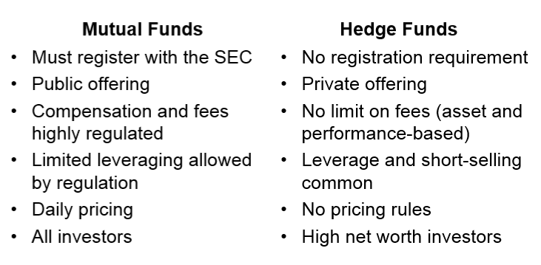
Mutual Funds vs. Hedge Funds
MFs and Other Investment Companies

Slide 25
Thanks!

