Slide 1
CAPM & APT

Slide 2
Summary
Risk and Return.
Portfolio Return and Risk
Diversification
Investors should diversify, thus individual securities will be held in a portfolio.
The risk that cannot be diversified away, i.e., the risk that remains when the stock is put into a portfolio, is called systematic risk (or non-diversifiable risk).
Examples of such events include a change in interest rates or GDP; or a financial crisis such as that which occurred in 2007 and 2008.
Optimum Risky Portfolio
Capital Allocation Line vs. Capital Market Line
Complete portfolio (combination of risk-free rate and optimum risky portfolio) provide more return per unit of risk are superior regardless of an individual’s risk tolerance (the principle of separation)
That is, portfolio choice can be separated into two independent tasks:
(1) determination of the optimal risky portfolio and
(2) the personal choice of the best mix of the risky portfolio and the risk free asset.
CAPM & APT

Slide 3
Measuring Risk in a Well-diversified portfolio
If a well diversified portfolio has no unsystematic risk then any risk that remains must be systematic;
The variation in returns of a well-diversified portfolio must be due to changes in systematic factors.
Remember:
(1) Total Risk of an individual asset = Systematic risk + Unsystematic risk
(2) The state of economy impacts securities in a different way
(3) If we hold well-diversified portfolio, any individual asset’s risk depends on the sensitivity of the asset on the systematic risk ONLY.
How can we measure the risk of an individual stock in a well diversified portfolio????
CAPM & APT

Slide 4
A Single-Index Stock Market
The scatter plot can also be used to illustrate systematic and unsystematic risk.
The risk is related to the systematic or macroeconomic factor, in this case the market index.
A stock’s total risk, as measured by its standard deviation, can be partitioned into systematic and unsystematic risk.
CAPM & APT

Slide 5
Understand the Components of a Single-Index Model
$R_{i}\left(t\right)=α_{i}+β_{i}R_{m}\left(t\right)$+ $e_{i}\left(t\right)$
Excess Return of a Security
Excess Return of Market
$$r_{i}−r_{f}$$
$$r_{M}−r_{f}$$
Expected return on the security’s in excess of risk-free rate beyond any induced by movements in the broad market
Firm Specific Surprises
The security’s sensitivity to market-wide economic shocks – measure of systematic risk
CAPM & APT

Slide 6
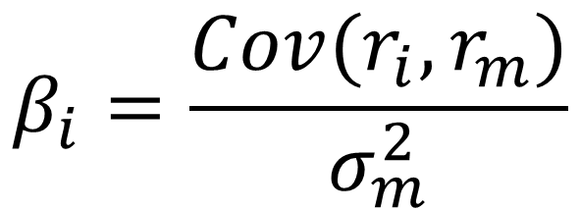
More about Beta - What does Beta represent?
Beta is the measure of the amount of systematic risk a stock has, or equivalently the amount of risk a stock will have when it is put into a well diversified portfolio.
Ri-rf
Rm-rf
$$β_{i}=\frac{Cov(r_{i}, r_{m})}{σ_{m}^{2}}$$
Variance of Market
CAPM & APT

Slide 7
Example 1)
A stock has a correlation with the market of 0.45. The standard deviation of the market is 21% and the standard deviation of the stock is 35%. What is stock’s beta?
CAPM & APT

Slide 8
Answer 1)
$$β_{i}=\frac{Cov(r_{i}, r_{m})}{σ_{m}^{2}}=\frac{ρσ_{i}σ_{m}}{σ_{m}^{2}}=\frac{0.45×0.35×0.21}{{0.21}^{2}}=0.75$$
CAPM & APT

Slide 9
Beta for Selected Induvial Stocks
Company | Industry | Beta
Consolidated Edison | Utilities | 0.08
Hershey | Food Processing | 0.64
General Mills | Food Processing | 0.73
eBay | Internet Service | 0.79
Intel | Semiconductors | 0.90
Apple | Computer Hardware | 0.96
Google | Internet Service | 1.07
Salesforce.com | Application Software | 1.30
Tiffany & Co. | Specialty Stores | 2.15
American Airline | Major Airlines | 3.85
CAPM & APT

Slide 10
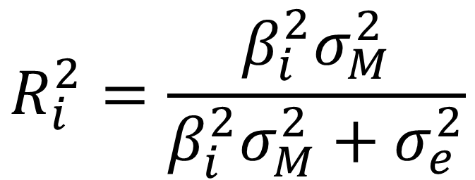
Measuring Components of Risk
A stock’s total risk, as measured by its standard deviation, can be partitioned into systematic and unsystematic risk.
$$R_{i}^{2}=\frac{β_{i}^{2}σ_{M}^{2}}{β_{i}^{2}σ_{M}^{2}+σ_{e}^{2}}$$
$$σ_{i}^{2}=β_{i}^{2}σ_{M}^{2}+σ_{e}^{2}$$
Total Risk or Total Variance
Systematic
Variance
Idiosyncratic
Variance
The ratio of explained variance to total variance.
The proportion of total variance can be attributed to market fluctuations
CAPM & APT

Slide 11
Total Risk vs. Beta
Consider the following information:
Standard Deviation Beta
Cisco 20% 1.43
Amgen 40% 0.58
Which stock has more systematic risk?
Which stock has more total risk?
CAPM & APT

Slide 12
Single Index Model and Finding Beta in Python
Launch U6-CAPM
Step 1,2,3
CAPM & APT

Slide 13
Example 2)
You run a regression for a stock’s return on a market index and find the following output:
What is the beta?
If standard deviation of market is 20%, what is the standard deviation of the stock associated with market?
What is the standard deviation of idiosyncratic risk?
CAPM & APT

Slide 14
Answer 2)
Beta=1.32
Variance(Stock)= ${1.32}^{2 }×{20}^{2}=697$ or Stdev(Stock)=26.4%
R2=Sys Var/Tot Var=Sys Var/(Sys Var+Idio Var)=0.12
0.12=697/(697+Idio Var) => Idio Var= 5111 = Idio Stdev=71.5%
CAPM & APT

Slide 15
Capital Asset Pricing Model (CAPM)
The CAPM defines the equilibrium relationship between risk premium, market risk premium, and beta.
Developed by William Shape, extension of Markowitz with some important differences!
Market Assumptions | Investor Assumptions
All investors are price takers | Investors plan for the same (single-period) horizon
All information relevant to security analysis is free and publicly available. | Investors are efficient users of analytical methods → investors have homogeneous expectations.
All securities are publicly owned and traded. | Investors are rational, mean-variance optimizers.
No taxes on investment returns.
No transaction costs.
Lending and borrowing at the same risk-free rate are unlimited.
CAPM & APT

Slide 16
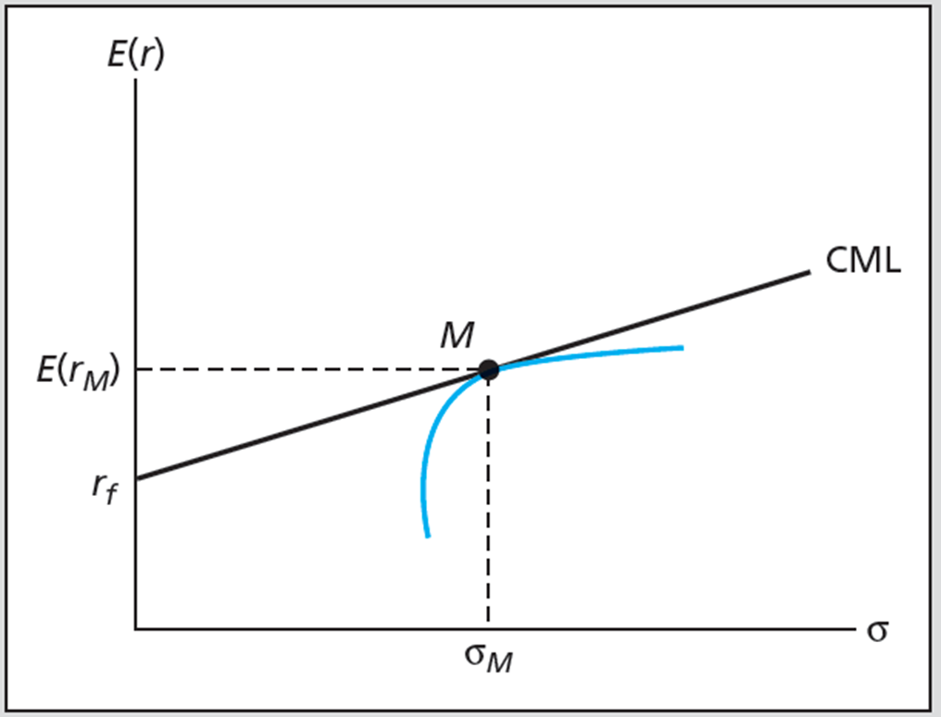
CAPM
In his model, Sharpe include risk-free rate and introduce the concept of a market portfolio that is a bundle of all possible investments in the world (both bonds and stocks and more).
Such a market portfolio is superior to any other portfolio (“superior optimum” or “theoretical” portfolio) and contains no idiosyncratic risk => only risk is systematic risk!!!
CAPM & APT

Slide 17

CAPM
$$E\left(R_{i}\right)−R_{f}=β_{i}\left[E\left(R_{m}\right)−R_{f}\right]$$
$E\left(R_{i}\right)$: expected return of risky asset $i$
$β_{i}$: beta of risk asset $i$
$E\left(R_{m}\right)$: market portfolio’s expected return
$R_{f}$: risk-free interest rate
CAPM & APT

Slide 18
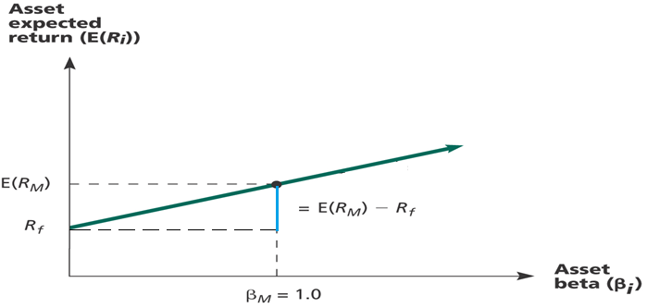
Security Market Line
CAPM & APT

Slide 19
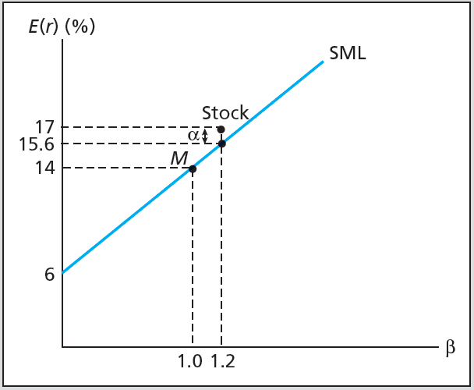
Example 3) – Understanding SML and alpha
Stock with Beta=1.2
E(Rm)=14%
Rf=6%
CAPM & APT

Slide 20
Implications (I) – Reward to Risk Ratio
Reward-to-Risk Ratio
$$\frac{E\left[R_{i}\right]−R_{f}}{β_{i}}$$
$E\left[R_{i}\right]$ = Risky asset i’s expected return
$R_{f}$ = Return from riskless assets
$β_{i}$ = Risky asset i’s beta
In a well-organized, active market, the reward-to-risk ratio should be the same across all risky assets in equilibrium
In a well-organized, active market, the reward-to-risk ratio should be the same as market risk premium in equilibrium
CAPM & APT

Slide 21
Implications (II) – Portfolio Beta
Calculating portfolio beta:
$$β_{p}=W_{1}β_{1}+W_{2}β_{2}+…+W_{n}β_{n}$$
$W_{n}=$ Weight of stock $n$ (Fraction of $ invested in stock $n$ )
$β_{n}=$ Beta of stock $n$
$β_{p}=$ Portfolio Beta
CAPM & APT

Slide 22
Example 4)
Suppose we had following investments:
What is the beta of this portfolio?
Does this portfolio have more or less systematic risk than the market portfolio?
Security | Amount Invested | Beta
Stock A | 1,000 | 0.80
Stock B | 2,000 | 0.95
Stock C | 3,000 | 1.10
Stock D | 4,000 | 1.40
Return, Risk, and SML

Slide 23
Answer 4)
Return, Risk, and SML

Slide 24
Example 5)
A stock has a beta of 1.13, the expected return on the market is 10.7%, and the risk-free rate is 4.6%. What must the expected return on this stock be?
CAPM & APT

Slide 25

Answer 5)
$E\left(R_{i}\right)={R_{f}+β}_{i}\left[E\left(R_{m}\right)−R_{f}\right]$
$=4.6+1.13x\left[10.7−4.6\right]=11.5\%$
CAPM & APT

Slide 26
Example 6)
Stock Y has a beta of 1.25 and an expected return of 12.6%. Stock Z has a beta of 0.8 and an expected return of 9.9%.
If the market is now in equilibrium, what would the risk-free rate have to be?
If the risk-free rate is 4.1% and market risk premium is 7%, are these stocks correctly priced? Why?
CAPM & APT

Slide 27
Answer 6)
In equilibrium:
$$\frac{12.6−r_{f}}{1.25}=\frac{9.9−r_{f}}{0.8} →r_{f}=5.1\%$$
CAPM & APT

Slide 28
Example 7)
You are examining two stocks – Bassett Inc and Hound Corporation. The risk-free rate is 3% and the return of market portfolio is 8%. The following table provides some information.
According to the CAPM, what is the expected return of the stock of Bassett Inc and Hound Corporation?
What is the actual percent return of the stock of Bassett Inc and Hound Corporation?
Draw the Security Market Line (SML), label axes, identify risk free asset and market portfolio. Identify where Bassett and Hound actually lie on this graph.
If you buy 200 shares of Bassett and 200 shares of Hound and $5,000 in Treasury bills, what would the portfolio beta be?
 |  |  | Next year
 | Beta | Current Price | Dividends (D1) | Price (P1)
Bassett | 1.1 | $25 | $1.00 | $26.13
Hound | 0.8 | $30 | $1.20 | $34.00
CAPM & APT
Notes:
B: 3+1.1*(8-3)=8.5 , H: 3+0.8*(8-3)=7%
B: (26.13+1-25)/25=8.52% , H: (34+1.20-30)/30=17.33%

Slide 29
CAPM in Real World
CAPM is false based on validity of its assumptions
Useful predictor of expected returns
Untestable as a theory
Principles still valid
Investors should diversify
Systematic risk is the risk that matters
Well-diversified risky portfolio can be suitable for wide range of investors
CAPM & APT

Slide 30
Multifactor Models and the CAPM
Multifactor models
Models of security returns that respond to several systematic factors
Two-index portfolio in realized returns
Two-factor SML
CAPM & APT

Slide 31
Example 8)
There are two independent economic factors, M1 and M2. The risk-free rate is 5%, and all stocks have independent firm-specific components with a standard deviation of 25%. Portfolios A and B are well diversified. Given the data below, which equation provides the correct pricing model?
Portfolio | Beta on M1 | Beta on M2 | E[rp]
A | 1.5 | 1.75 | 35%
B | 1 | 0.65 | 20%
CAPM & APT

Slide 32
Solution 8)
35 = 5 + 1.5 x E(Rm1) + 1.75 x E(Rm2) … (1)
20 = 5 + 1.0 x E(Rm1) + 0.65 x E(Rm2) … (2)
Solve them for E(Rm1) and E(Rm2).
E(Rm1)=8.71%, E(Rm2)=9.68%
CAPM & APT

Slide 33
Fama-French Three (Five) factor Model
The Fama-French (FF) three factor model has become a standard in equity analysis.
What is FF Model?
The FF model was developed because the researchers found that stocks of smaller firms, and of firms with a high book-to-market ratio, had higher stock returns than predicted by single factor models.
Recently, FF included and profitability and asset growth!
Critique of FF Models:
The FF model is based on empirical regularities that are apparently longstanding in the data.
Nevertheless it is a model without a sound theoretical underpinning.
This raises questions about whether the priced factors will remain significant in the future.
$$r_{G}−r_{f}=α_{G}+β_{M}\left(r_{M}−r_{f}\right)+β_{HML}r_{HML}+β_{SMB}r_{SMB}+e_{G}$$
CAPM & APT

Slide 34
Basic Intuition of the Factor Models
Let’s compare small vs large stocks and growth vs. value stocks.
Launch U6-CAPM - STEP 4
If small firms, on average, outperform large firms => do you think a manager who is investing small (value) firms is better manager than other manager who is investing large (growth) firms? Or simply taking some risk????
Factor models attempt to compare skills of managers or portfolios by controlling for certain documented patterns (small stock premium or value premium or profitability premium etc.)
CAPM & APT

Slide 35
CAPM, 3- and 5-Factor Model in Python
Launch U6-CAPM
Step 5
CAPM & APT

Slide 36
Thanks!

