Slide 1
Macroeconomic and Industry Analysis
&
Equity Valuation

Slide 2
Picking a Stock
How to pick a stock?
What tools do you need?
Economics (both macro and micro)
The relation between economy (market) and industries.
Accounting (financial statement analysis or financial ratios) to pick a stock
Security Analysis
Notes:
A wide mix of skills.
economics (both micro and macro) => to forecast the general direction of the market and the relative position of articular industries or firms
Understand the industries (ins and outs of particular industries)
Choose a specific firm within an industry
Understand accounting i.e., financial statements, financial ratios etc. More importantly how to apply accounting when selecting stock

Slide 3
Top-Down Approach
Global Economy
Domestic Macroeconomy
GDP
Employment
Inflation
Interest Rates
Federal Government Policy
Sentiment
Security Analysis

Slide 4
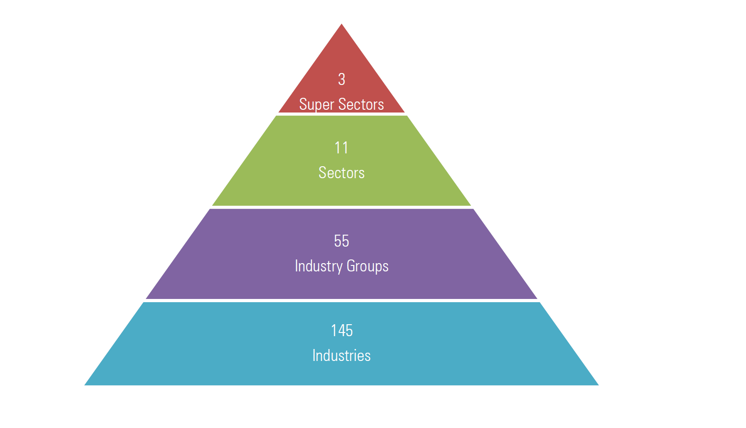
Understanding Sectors and Industries in Practice
The best example is from Morningstar (www.morningstar.com).
Let’s have a look: (http://advisor.morningstar.com/Enterprise/VTC/MorningstarGlobalEquityClassStructure2019v3.pdf)
Three groups: Cyclical, Defensive, and Sensitive
It is the general sphere a firm does business
Based on firms’ common operational characteristics.
Based on annual reports, 10Ks as its primary source
Security Analysis

Slide 5
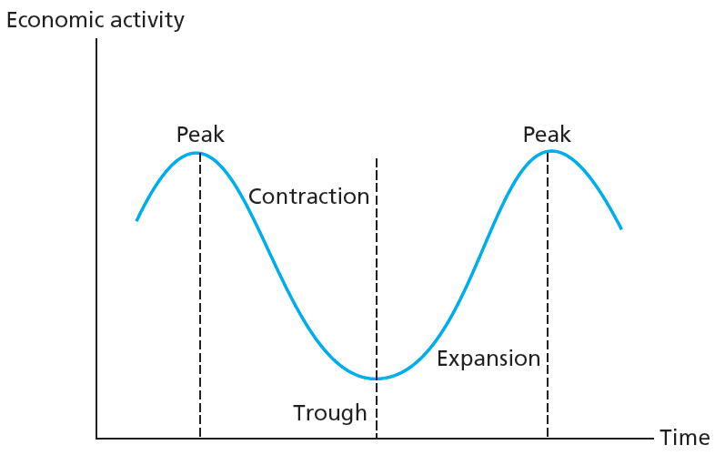
Why is it important?
Business Cycles
Recurring cycles of recession and recovery
Peak
Transition from end of expansion to start of contraction
Trough
Transition point between recession and recovery
Security Analysis

Slide 6
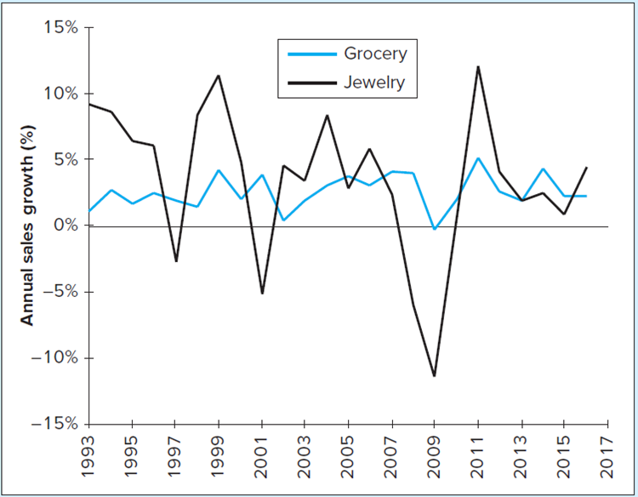
Cyclical vs. Defensive Industries
Cyclical Industries
Industries with above-average sensitivity to state of economy
Defensive Industries
Industries with below-average sensitivity to state of economy
How about Morningstar Classifications:
Cyclical -> Industries significantly affected by economic shifts
Defensive -> Industries that are relatively immune to economic cycles
Sensitive -> Industries affected by economic shifts but severely
Security Analysis

Slide 7
Is Economic Cycles Predictable?
Leading Indicators:
Avg. weekly hours of productive workers, unemployment insurance, manufacturers’ new orders, stock prices etc.
Coincident Indicators:
Employees on nonagricultural payrolls, industrial production, etc.
Lagging Indicators:
Average duration of unemployment, change in consumer price index, inventory to sale ratio
Security Analysis

Slide 8
Examples
Index of consumer expectations for business conditions:
https://conference-board.org/data/consumerdata.cfm
https://data.oecd.org/leadind/consumer-confidence-index-cci.htm#indicator-chart
Initial claims for unemployment insurance:
https://fred.stlouisfed.org/series/ICSA
New orders for nondefense capital goods:
https://fred.stlouisfed.org/series/NEWORDER
New private housing units authorized by local building permits
https://fred.stlouisfed.org/series/PERMIT
Security Analysis

Slide 9
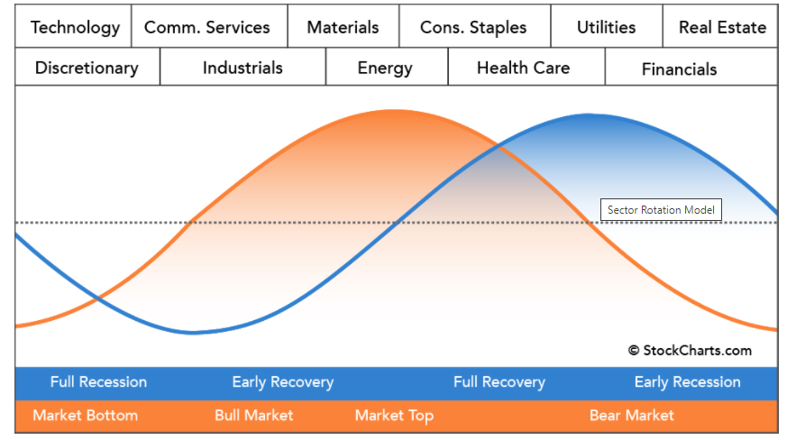
Sector Rotation Analysis
Sector Rotation Analysis attempts to link current strengths and weaknesses in the stock market with the general business cycle based on the relative performance of the eleven Sectors.
Once you have identified the strong and weak sectors, you can then compare the results to a theoretical business cycle chart and - hopefully - determine the part of the business cycle the market is in.
That information, in turn, may help you predict which sectors will strengthen in the coming weeks and months.
The economic cycle in blue, the stock market cycle in orange and the best performing sectors at the top.
MORE: https://school.stockcharts.com/doku.php?id=market_analysis:sector_rotation_analysis
Security Analysis

Slide 10
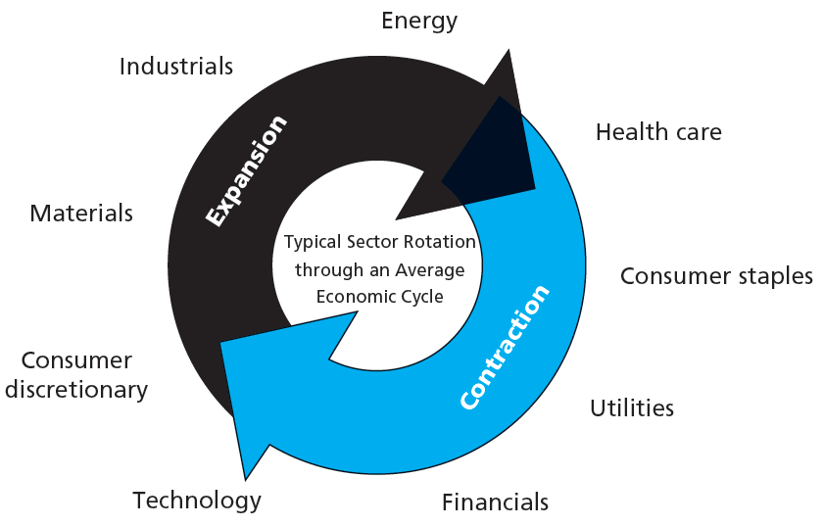
Sector Rotation:
Shifting portfolio into industry sectors expected to outperform
Based on macroeconomic forecasts
After peak, defensive industries often better performers
In trough, capital goods industries often better performers
In expansion, cyclical industries often better
Security Analysis

Slide 11
From Sector Selection to Stock Picking – Financial Statements
Balance Sheet: Accounting statement of firm’s financial position at specified time.
Income Statement: Financial statement showing firm’s cash receipts and cash payments during specified period.
Accounting Earnings | Economic Earnings
Earnings of a firm as reported on income statement | Real flow of cash firm could pay without impairing productive capacity
Security Analysis

Slide 12
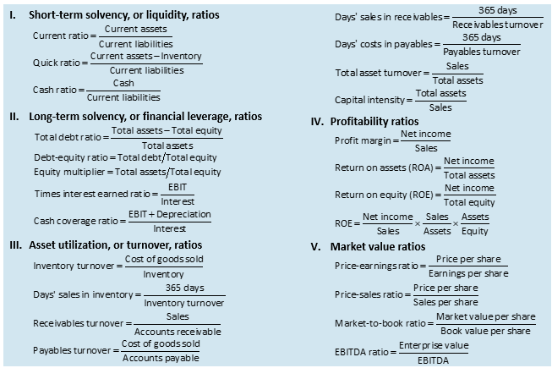
From Sector Selection to Stock Picking
List of Financial Ratios:
Security Analysis

Slide 13
How to use Financial Ratios?
Security Analysis

Slide 14
Some Key Ratios
Profitability Ratios:
ROA: NI/TA
ROE: NI/TE
ROIC: EBIT/Long-Term Capital (LT Debt+Equity)
Operating Margin: (Sales-COGS-SG&A)/Sales
Market Valuation Ratios:
Price/Sales (P/S)
Price/Earnings (P/E)
PEG: Ratio of P/E to earnings growth rate
g=ROE x b, where b is plowback (retention) ratio.
PEG <=1 => fairly valued, PEG>1 => overvalued
Enterprise Value/EBITDA
Enterprise Value: total market value of the stock + book value of all liabilities – cash.
Alternative to P/E
Security Analysis

Slide 15
Putting Altogether
In-Class Lab:
LAB – Stock Selection
LAB – Stock Selection
LAB - Stock Selection - REPORT
Security Analysis

Slide 16
Thanks!

