Slide 1
Investment Portfolio &
Diversification

Slide 2
Portfolio
Investment Portfolio
Collection of financial assets (including stocks, bonds, commodities, cash).
The idea here, select number of stocks (i.e., stock picking) and optimize the rate of return of the portfolio (i.e., optimization).
Before learning more about how to optimize the portfolio, let’s explore how to find the rate of return of a portfolio.
Risk and Return

Slide 3
Portfolio Return
Example of a Portfolio
$$R^{Portfolio}= \sum_{i=1}^{N}{R^{i}×w^{i}}$$
Stock X
$$R^{X}=32\%$$
$$w^{X}=0.25$$
Stock Y
$$R^{Y}=15\%$$
$$w^{Y}=0.25$$
$R^{Portfolio}= R^{X}×w^{X}+R^{Y}×w^{Y}$+ $R^{Z}×w^{Z}$+ $R^{W}×w^{W}$
Stock Z
$$R^{Z}=12\%$$
$w^{Z}=$0.25
$R^{Portfolio}=32\% \left(0.25\right)+15\%\left(0.25\right)+12\% \left(0.25\right)+$13% (0.25)
Stock W
$$R^{W}=13\%$$
$$w^{W}=0.25$$
$R^{Portfolio}=$ 18%
Equally weighted
Risk and Return

Slide 4
Example 8)
You have $13,000 to invest in a stock portfolio. Your choices are Stock X with an expected return of 15% and Stock Y with an expected return of 9%. Assume your goal is to create a portfolio with an expected return of 12.35%. How much money will you invest in Stock X and Stock Y?
Risk and Return

Slide 5
Example 8 - Answer
Rp=12.35%, Rx=15%, and Ry=9%
Rp=Rx wx + Ry wy
12.35 = 15 wx + 9 Ry wy
Remember: (wx+wy)=1 => wy= (1- wx)
In other words; 12.35 = 15 wx + 9 (1- wx)
wx =0.56 and wy= (1- wx)= 1-0.56=0.64
$ Invested in X = $13,000 x 0.56 = $7,280
$ Invested in Y = $13,000 x 064 = $8,320
Risk and Return

Slide 6
How about Portfolio Risk?
Measuring Portfolio Risk is not as “straight forward” as measuring risk.
This is because portfolio risk depends not only on the risk of an individual stock in the portfolio but also on the relationships between the stocks in the portfolio.
Portfolio variance is function of the variances of the stocks and covariances (correlations) between them!!!!
Let’s understand why this is the case!!!!
Risk and Return

Slide 7
The Benefits of Portfolio Diversification
The relationship between securities:
Price of securities is affected the by the same factors
The most obvious example is, as we discussed previously, development of the economy
Favorable macroeconomic conditions facilitate the business of all companies
Consumer Spending
Business
Jobs
Diversification

Slide 8
The Benefits of Portfolio Diversification
However, the state of economy impacts industries in a different way
Who do you think will suffer more at a time of crisis?
Car makers or supermarket chains
How important is this to an investor building a portfolio of stocks?
VERY IMPORTANT!!!!
What “factors” affect stock prices?
Macroeconomic predictors.
Stock Characteristics.
Diversification

Slide 9
Hypothetical Example
You own one stock of tech company: Google
Let's assume you expect the same rate of return from the two shares(FB and WMT) which is probably unrealistic but will serve us well for this example.
So all else being equal. Are you going to choose FB or Walmart?
Diversification

Slide 10
Principle of Diversification
Diversification:
The process of spreading an investment across assets and thereby forming portfolios
Principle of diversification
Spreading an investment across many assets will eliminate some of the risk (diversifiable risk)
There is a minimum level of risk (non-diversifiable risk) that cannot be eliminated simply by diversifying.
Bottom Line:
There is a relationship between prices of different companies.
It is very important to understand what causes this relationship and how to use this measurement to build optimal investment portfolios.
Diversification

Slide 11
Covariance and Correlation
How to quantify the relationship between two securities?
$$Cov\left(A,B\right)=\frac{\sum{(R_{A}−\overline{R_{A}})×(R_{B}−\overline{R_{B}})}}{N−1}$$
$$ρ_{A,B}=\frac{Cov(A,B)}{σ_{A}σ_{B}}$$
Covariance: Measure of how changes in one variable are associated with in a second variable
Correlation: The extent to which two variables fluctuate together
Diversification

Slide 12
Example (1)-Covariance and Correlation
Year | Security A | Security B
1 | -3% | 40%
2 | -4% | -20%
3 | 6% | -10%
4 | 5% | 40%
Security A |  | Security B
Avg. R=1% |  | Avg. R=12.5%
Stdev= 5.2% |  | Stdev= 32.0%
Year 1
Year 2
Year 3
Year 4
A
B
A
B
A
B
A
B
$$Cov\left(A,B\right)=\frac{\left(−3−1\right)×\left(40−12.5\right)+\left(−4−1\right)×\left(−20−12.5\right)+\left(6−1\right)×\left(−10−12.5\right)+(5−1)×(40−12.5) }{(4−1)}$$
Diversification

Slide 13
Example (1)-Covariance and Correlation
If Cov>0 =>The two variables move in the same direction
If Cov<0 =>The two variables move in the opposite direction
If Cov=0 =>The two variables are independent
$$Cov\left(A,B\right)=16.67$$
-1 <= Correlation <= +1
Correlation =+1 (perfectly positive)
Correlation =-1 (perfectly negative)
Correlation = 0 (No Correlation)
$$ρ_{A,B}=\frac{Cov(A,B)}{σ_{A}σ_{B}}=\frac{16.67}{5.22×37.75}=0.085$$
Diversification

Slide 14
Portfolio Variance
Recap:
We learned how to measure the “Expected Return” of a financial security.
We learned how to measure the variability of financial security – A volatile stock is much likelier to deviate from its historical returns and surprise investors.
We learned how to assess the relation between different financial securities.
Now it’s time to consider a portfolio of at least two stocks.
We learned how to calculate the expected rate of return of portfolios with two or more stocks.
Let’s discuss the calculation of a variance of a portfolio.
Portfolio Variance

Slide 15
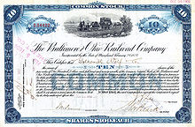
Portfolio Variance
Correlation
Stock A
Stock B
Variance of Stock A
Variance of Stock B
Stock Portfolio
Portfolio Variance
Notes:
If a portfolio contains two stocks its risk will be a function of the variances of the two stocks and the correlation between them.

Slide 16
Portfolio Variance
VS.
Do you think these two portfolios have same risk???
Portfolio Variance

Slide 17
Portfolio Variance
wA: proportion of stock A held in the portfolio
wB: proportion of stock B held in the portfolio
Portfolio Variance (2 stocks): A and B
$$σ_{P}^{2}=w_{A}^{2}σ_{A}^{2}+2w_{A}w_{B}COV\left(A,B\right)+w_{B}^{2}σ_{B}^{2}$$
Remember:
$$ρ_{A,B}=\frac{Cov(A,B)}{σ_{A}σ_{B}}$$
$$σ_{P}^{2}=w_{A}^{2}σ_{A}^{2}+2w_{A}w_{B}σ_{A}σ_{B}ρ_{A,B}+w_{B}^{2}σ_{B}^{2}$$
Portfolio Variance

Slide 18
Example (2)
 | Stock A | Stock B |  | Portfolio
w | 0.5 | 0.5
Expected Return | 1% | 12.5% |  | 6.75%
Std. Dev | 5.2% | 32.0%
Covariance Correlation | 16.67 0.085
$$σ_{P}^{2}=w_{A}^{2}σ_{A}^{2}+2w_{A}w_{B}COV\left(A,B\right)+w_{B}^{2}σ_{B}^{2}$$
$$σ_{p}^{2}={0.5}^{2}×{5.2}^{2}+2×0.5×0.5×16.67+{0.5}^{2}×{32}^{2}=271.42$$
$$σ_{p}=\sqrt{271.42}=16.5\%$$
Portfolio Variance

Slide 19
Example (2)
 | Stock A | Stock B |  | Portfolio
w | 0.5 | 0.5
Expected Return | 1% | 12.5% |  | 6.75%
Std. Dev | 5.2% | 32.0% |  | 16.5%
Covariance Correlation | 8.34 0.24
$$σ_{p}=\sqrt{271.42}=16.5\%$$
Portfolio Variance

Slide 20
Closer Look at the Implications
I have three options:
(1) A portfolio invested solely in Stock A
(2) A portfolio invested solely in Stock B
(3) A portfolio invested in Stock A and Stock B (50% and 50%)
How can I identify which option (or combination) better??
 | Expected Return | Std. Dev.
Stock A | 1% | 5.2%
Stock B | 12.5% | 32%
Portfolio | 6.75% | 16.5%
Diversification

Slide 21
Risk Premiums and Risk Aversion
How much, if anything, would you invest in U.S. Equity Market/or risky stocks?
You must ask how much of an expected reward is offered to compensate for the risk.
We measure “reward” as the difference between the expected return and the risk-free rate. We call this difference the risk premium.
A reasonable proxy of an asset’s risk premium is the average of historical excess return (difference between return and the risk-free rate).
Diversification

Slide 22
Risk Aversion and Sharpe Ratio
The degree to which investors are willing to invest in risky investments (individual stocks) in on their risk aversion.
On average, investors are risk averse. That is, without a positive risk premium, they would not be willing to invest in stocks.
In theory, there must always be a positive risk premium in order to induce risk-averse investors to hold risky assets.
Risk aversion implies that investors will demand a higher reward (as measured by their portfolio risk premium to accept higher portfolio volatility.
One commonly used measure is called Sharpe Ratio (industry standard)
Diversification

Slide 23

Sharpe Ratio
$$S_{P} = \frac{Portfolio Risk Premium}{Standard Deviation of Excess Returns}\frac{E\left(r_{p}\right)−r_{f}}{σ_{P}}$$
$$Where$$
$$E\left(r_{p}\right) = Expected Return of the portfolio \\ r_{f} = Risk Free rate of return \\ σ_{P} = Standard Deviation of portfolio excess return$$
Diversification

Slide 24
Understanding Sharpe Ratio
Sharpe Ratio is the ratio of average excess return over standard deviation (per unit of volatility or total risk).
Ranking portfolios by Sharpe ratios. NOT STOCKS!!!!!!!
Diversification

Slide 25
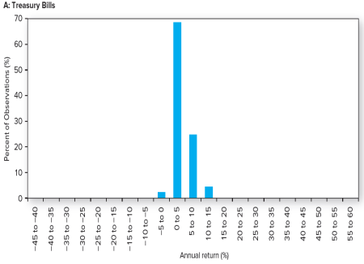
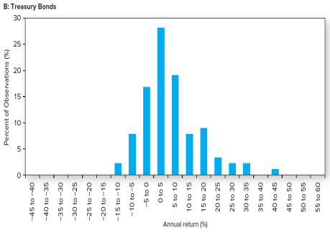
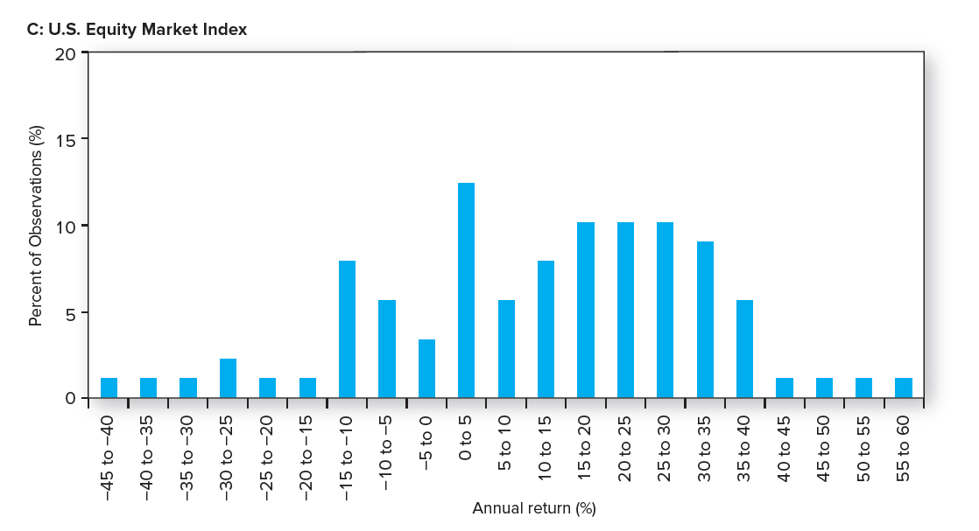
Historical Return and Risk
Risk and return of investment in major asset classes, 1927-2016
 | T-bills | T-bonds | Stocks
Arithmetic average | 3.42 | 5.51 | 11.91
Standard deviation | 3.14 | 8.14 | 19.99
max | 14.71 | 38.07 | 56.38
min | −0.02 | −8.47 | −43.73
Diversification

Slide 26
Closer Look at the Implications
Let’s assume risk-free rate is zero
 | Expected Return | Risk-Free Rate | Risk-Premium | Std. Dev. | Sharpe Ratio
Stock A | 1% | 0% | 1% | 5.2% | 0.19
Stock B | 12.5% | 0% | 12.5% | 32% | 0.39
Portfolio | 6.75% | 0% | 6.75% | 16.5% | 0.41
Diversification

Slide 27
Calculating Portfolio Return in Python
Let’s open Python code for this Lecture “Week 4-Lecture-Diversification and Portfolio”
What will be learning?
(1) to analyze three stocks’ returns stand alone basis – GOOG, WMT, and FB
(2) how to interpret covariances and correlation across these stocks
(3) to compare Sharpe Ratio of two portfolios (GOOG and WMT vs. GOOG and FB) => this gives us an opportunity to investigate the theory we learned in this class holds.
Diversification

Slide 28
Thanks!

